Slide 1
What is an Entrepreneur?
By Megan Rees

Slide 2
Entrepreneur
One who organizes, manages, and assumes the risks of a business or enterprise.

Slide 3
Entrepreneurship can be risky…
Sporadic Income
Business will fail and lose investment
Possibly liable for debts
Harder to find work or start again
Less Security (perhaps)

Slide 4
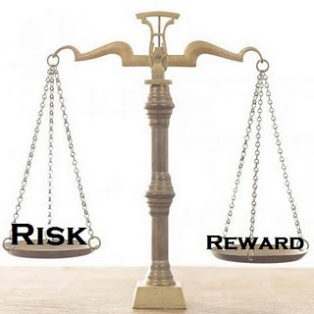
Taking a Calculated Risk
“A risk that has been given thoughtful consideration and for which the potential costs and potential benefits have been weighted and considered.”
Owner-entrepreneurship education empowers young people to make well-informed decisions about their future, whether they choose to become entrepreneurs or not.

Slide 5
Non-Financial Rewards
Independence
A sense of satisfaction
Building something
Being in control
Employing more people
Making a contribution to community

Slide 6
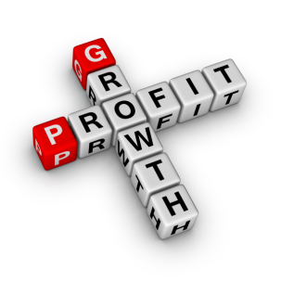
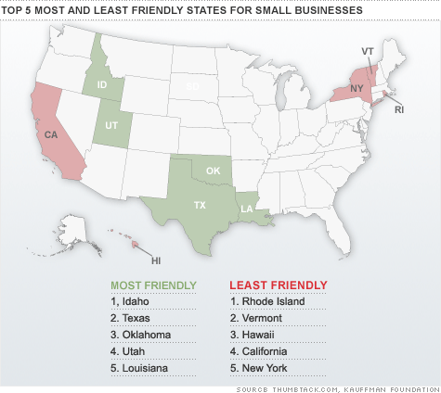
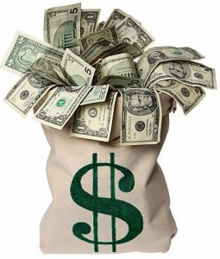
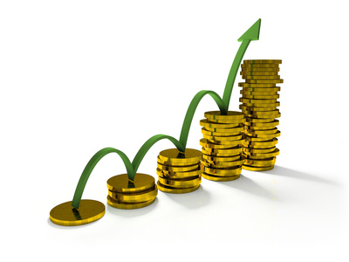
Financial Rewards
Profits
Capital Growth
Facebook - Mark Zuckerberg launched Facebook around age 20
The Body Shop – Dame Anita Roddick started at age 27 with 15 products
Spanx – Sara Blakely started at age 28
Wal-Mart – Sam Walton started at age 26

Slide 7
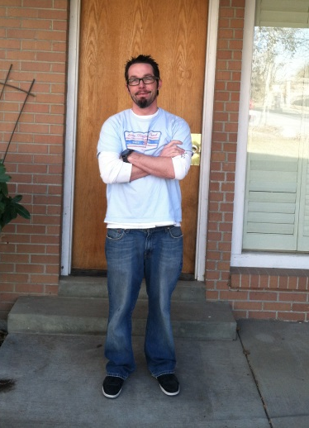
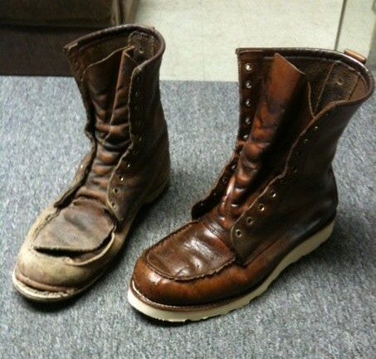
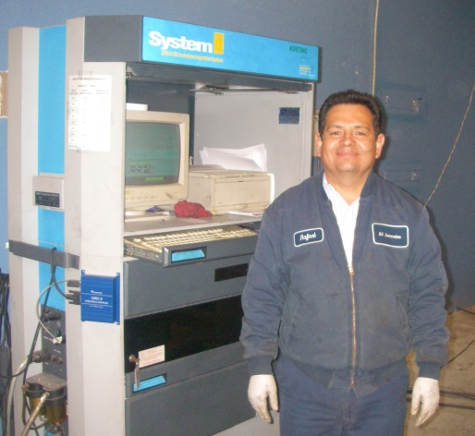
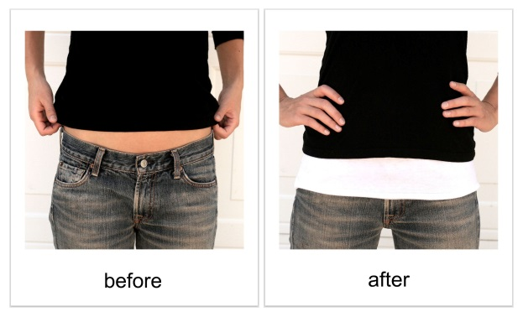
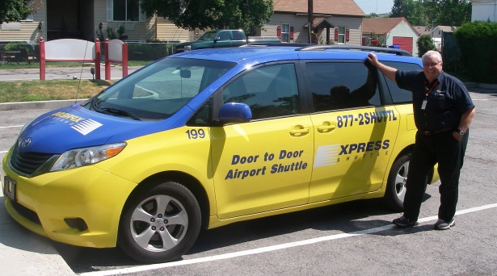
Find a “need” (opportunity) and figure out how to meet it
A “need” for a sober living environment
A “need” for shoe and leather repair
A “need” for car inspections
A “need” for airport transportation
A “need” for child care.
A “need” for a shirt extender

Slide 8
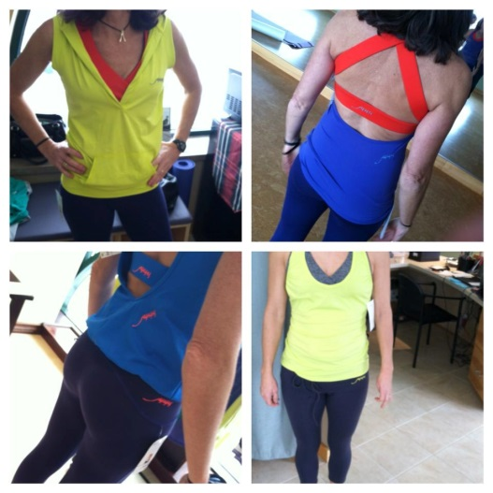
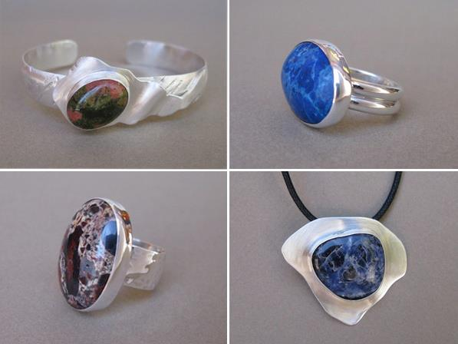
Find a “want” (opportunity) and figure out how to meet it
A “want” to snow-kite
A “want” for chic, fun fitness apparel.
A “want” to make own jewelry and wedding rings
A “need” for a hostess gift and a “want” for chocolate

Slide 9
Why should students care about entrepreneur education?
Entrepreneurship allows you to dream your own destiny and craft a job that you can excel at.
If you're going to spend time doing something, why not spend time doing something you love? Pursue your passion.
Resume Builder. What looks better on a resume -- someone who started a lawn-mowing business and made sales as a teenage or someone who worked as a cashier in a local supermarket?
Students already own five powerful assets: time, talent, attitude, energy and unique knowledge of one’s local market.

Slide 10
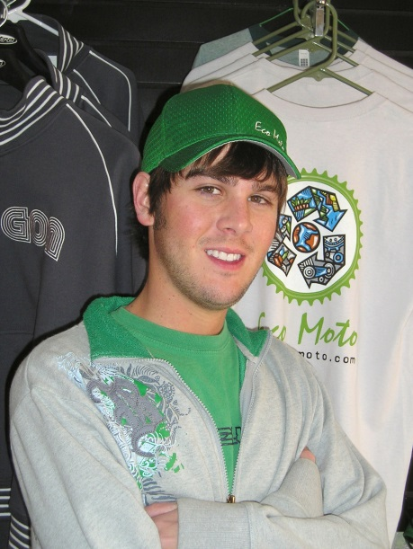
Why should parents care about entrepreneurship education?
“I’ve seen apathetic kids whose families have been on welfare for generations get excited about school and their futures. They discover that they can participate in our economy and earn money. They quickly realize that to do so, they must to learn to read, write and do math.”
“I’ve also seen how owning even the simplest small business fills a teen with pride.”
* Why Every School in America Should Teach Entrepreneurship, Steve Mariotti – Network for Teaching Entrepreneurship (NFTE)

Slide 11
Who is this Entrepreneur?
1954 - Present
Net Worth: $2.7 Billion
Industry: Entertainment
Born in poverty, abused as a child.
Talk Show Host
Owns a company called Harpo Studios
Has over 250 employees
Co-founded Oxygen Media
Oprah
Winfrey

Slide 12
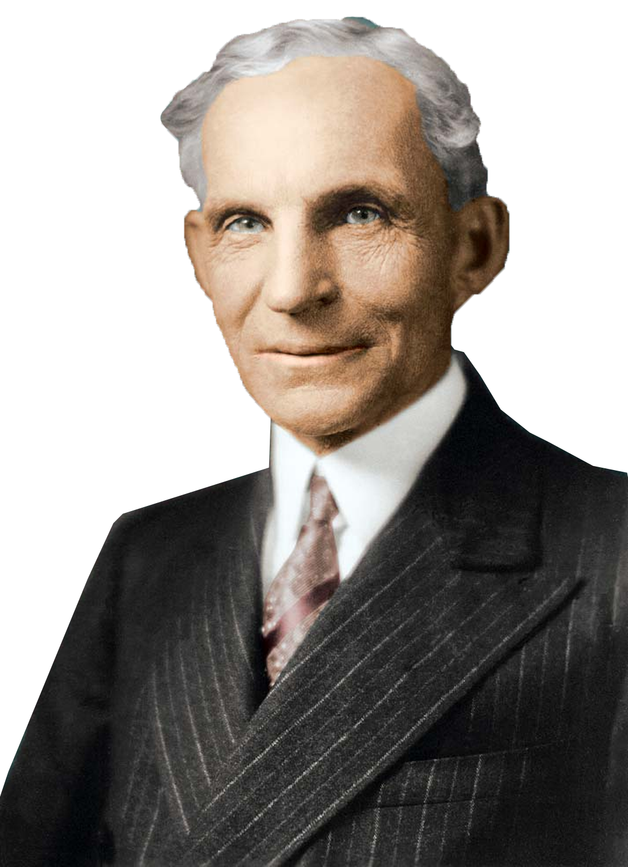
Who is this Entrepreneur?
1863-1947
Net Worth: $1.1 Billion
Industry: Auto-motive
Son of a farmer
Had Dyslexia
Friends with Thomas Edison
Invented the assembly line
Had two failed businesses before he succeeded.
Henry
Ford

Slide 13
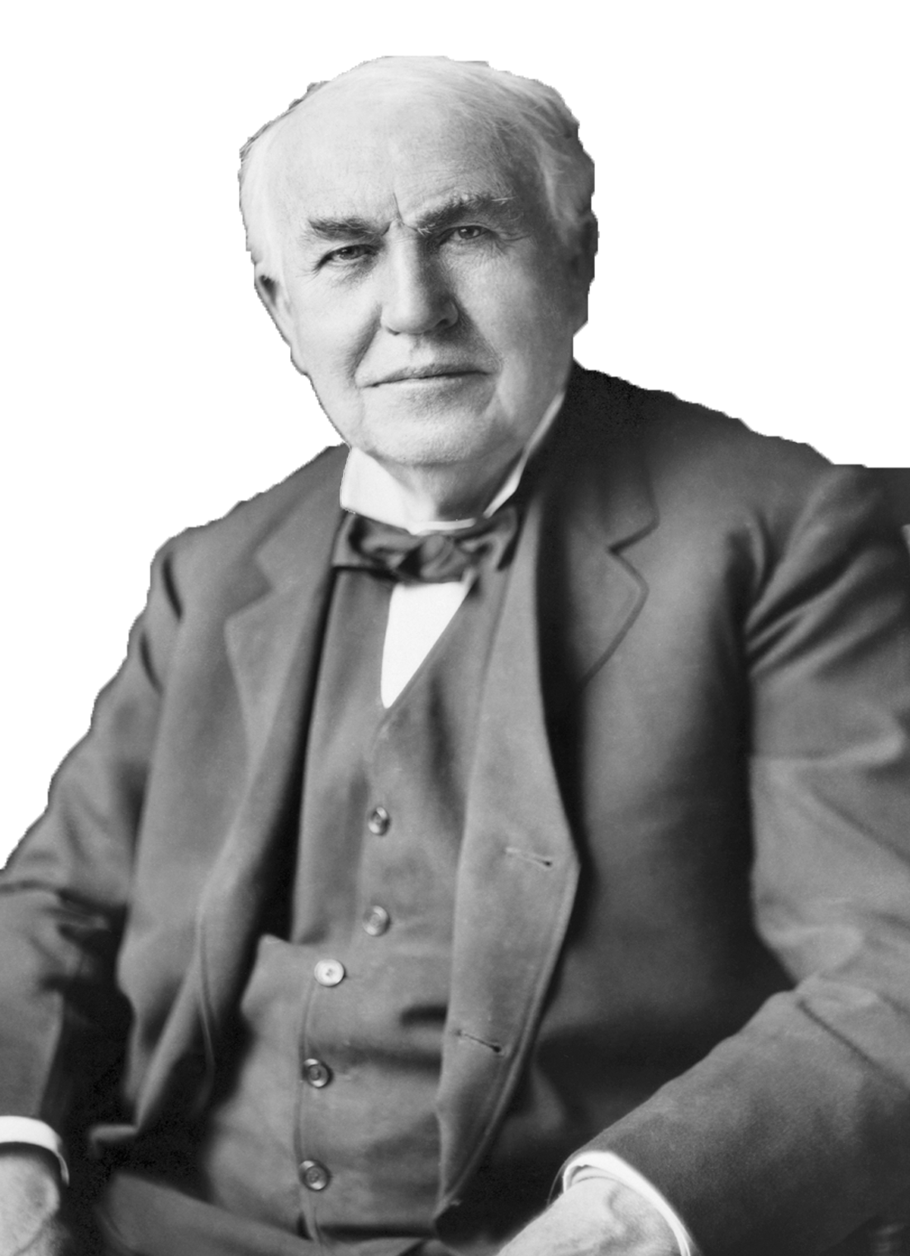
Who is this Entrepreneur?
1847- 1931
Net Worth: $12 Million
Industry: Science
Born poor, deaf in one ear
Created thousands of inventions and patents
Failed more times than he succeeded!
His inventions changed the world.
Thomas
Edison

Slide 14
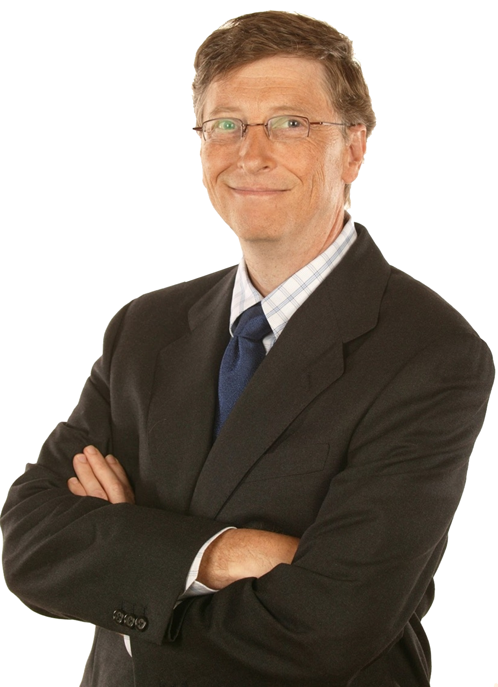
Who is this Entrepreneur?
1955 - Present
Net Worth: $53 Billion
Industry: Information Technology
Second richest person on the planet
Born into an upper-class family
Began his career at age 13
His technology is standard world wide.
Bill Gates

Slide 15
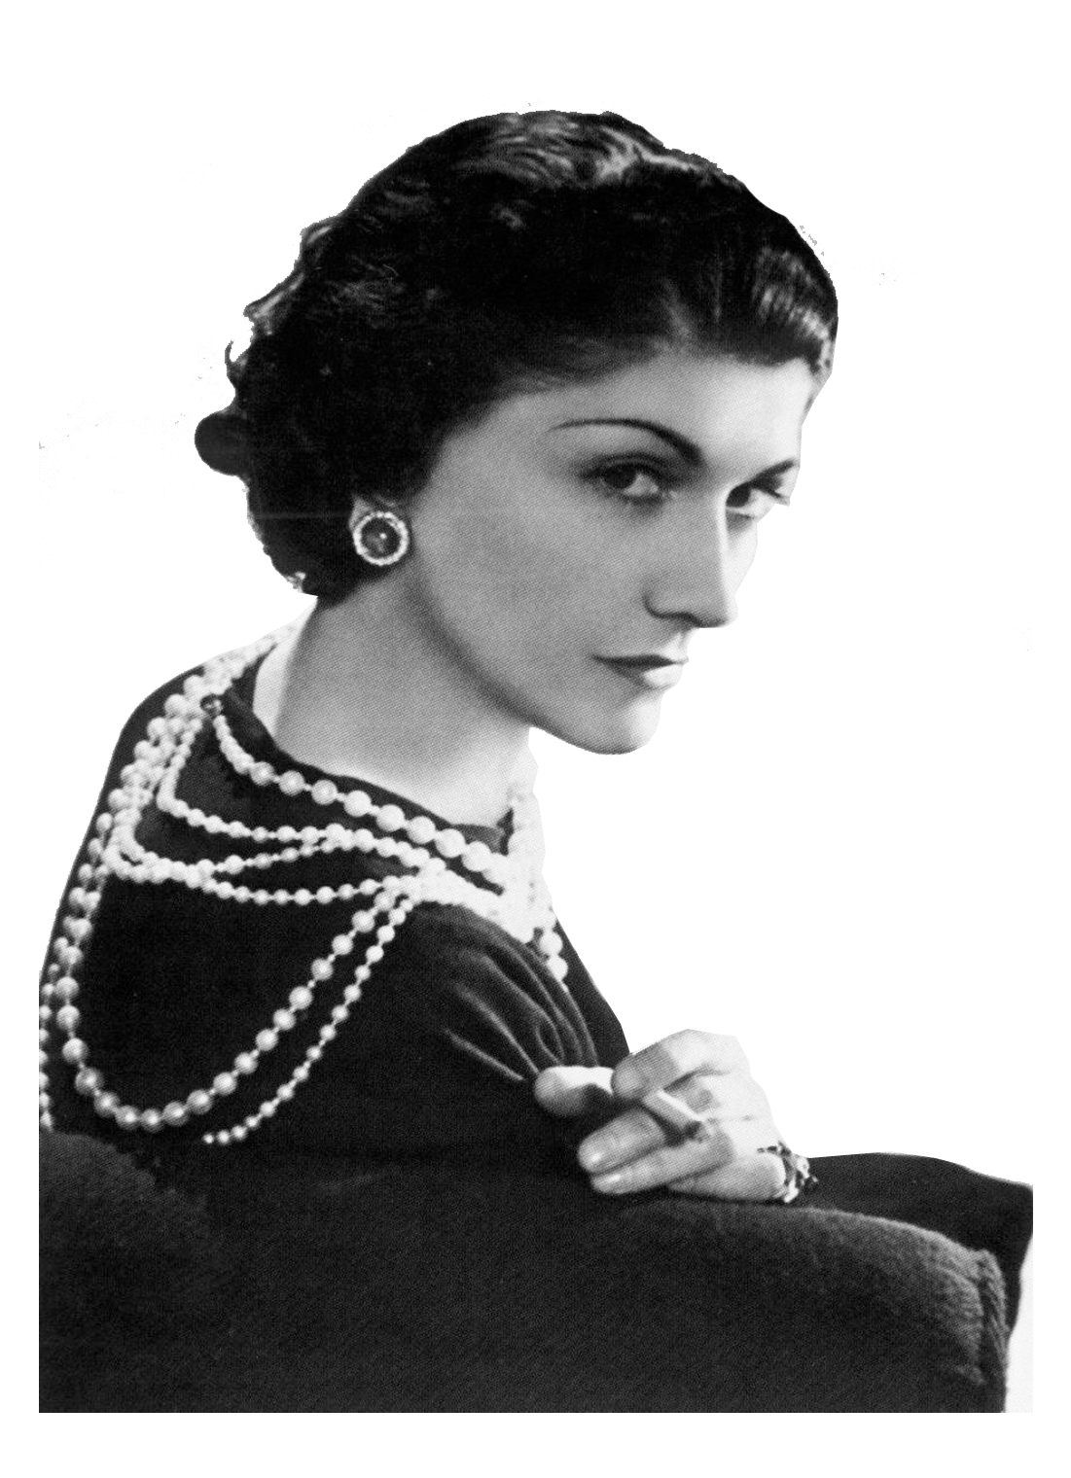
Who is this Entrepreneur?
1883 - 1971
Net Worth: $160 Million
Industry: Fashion
Born in a workhouse, then sent to an orphanage at 6.
A failed singer, then opened a hat shop
Her perfume is still worn today
Coco Chanel

Slide 16
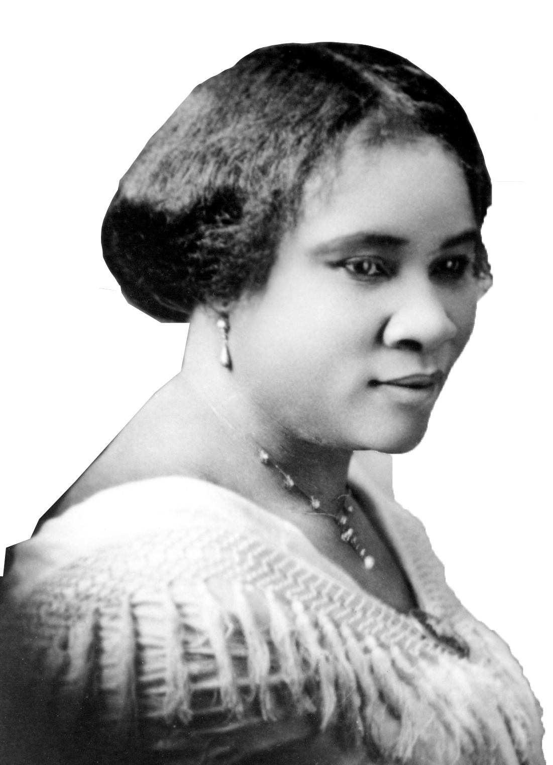
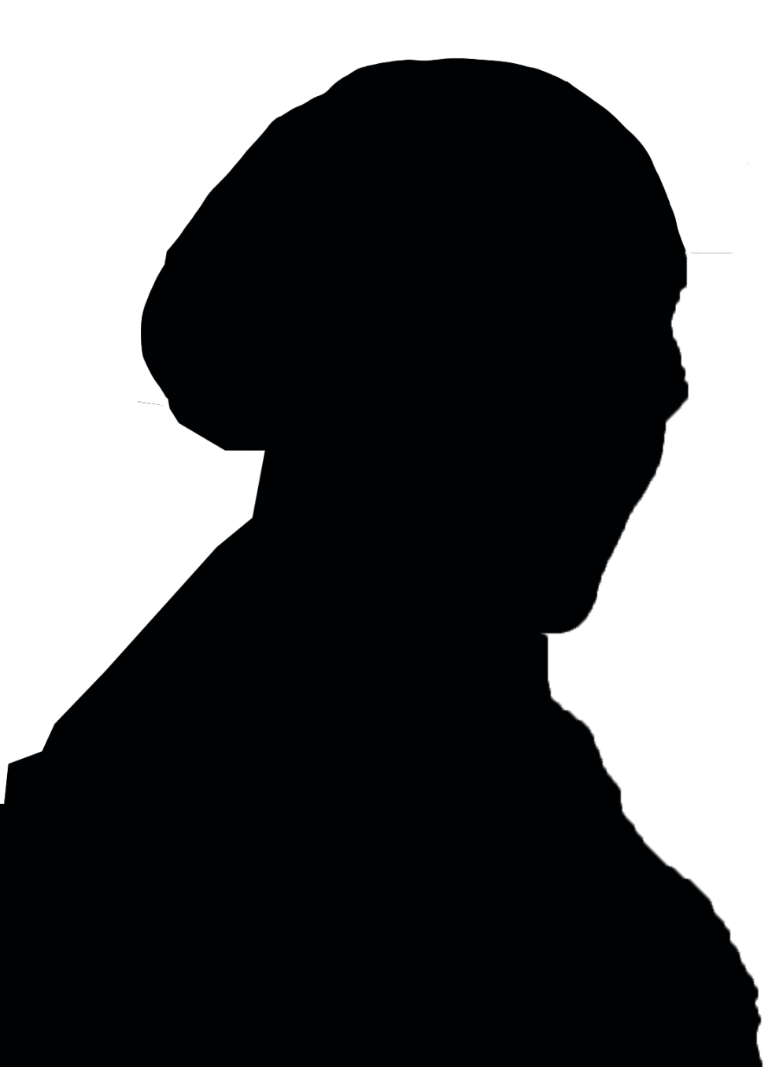
Who is this Entrepreneur?
1867-1919
Net Worth: $600,000
Industry: Haircare
Known as one of the first African-American entrepreneurs
Born just after her slave parents were freed
Orphaned at 7
One of the wealthiest women in her area
Helped female entrepreneurs
Madame C. Walker

Slide 17
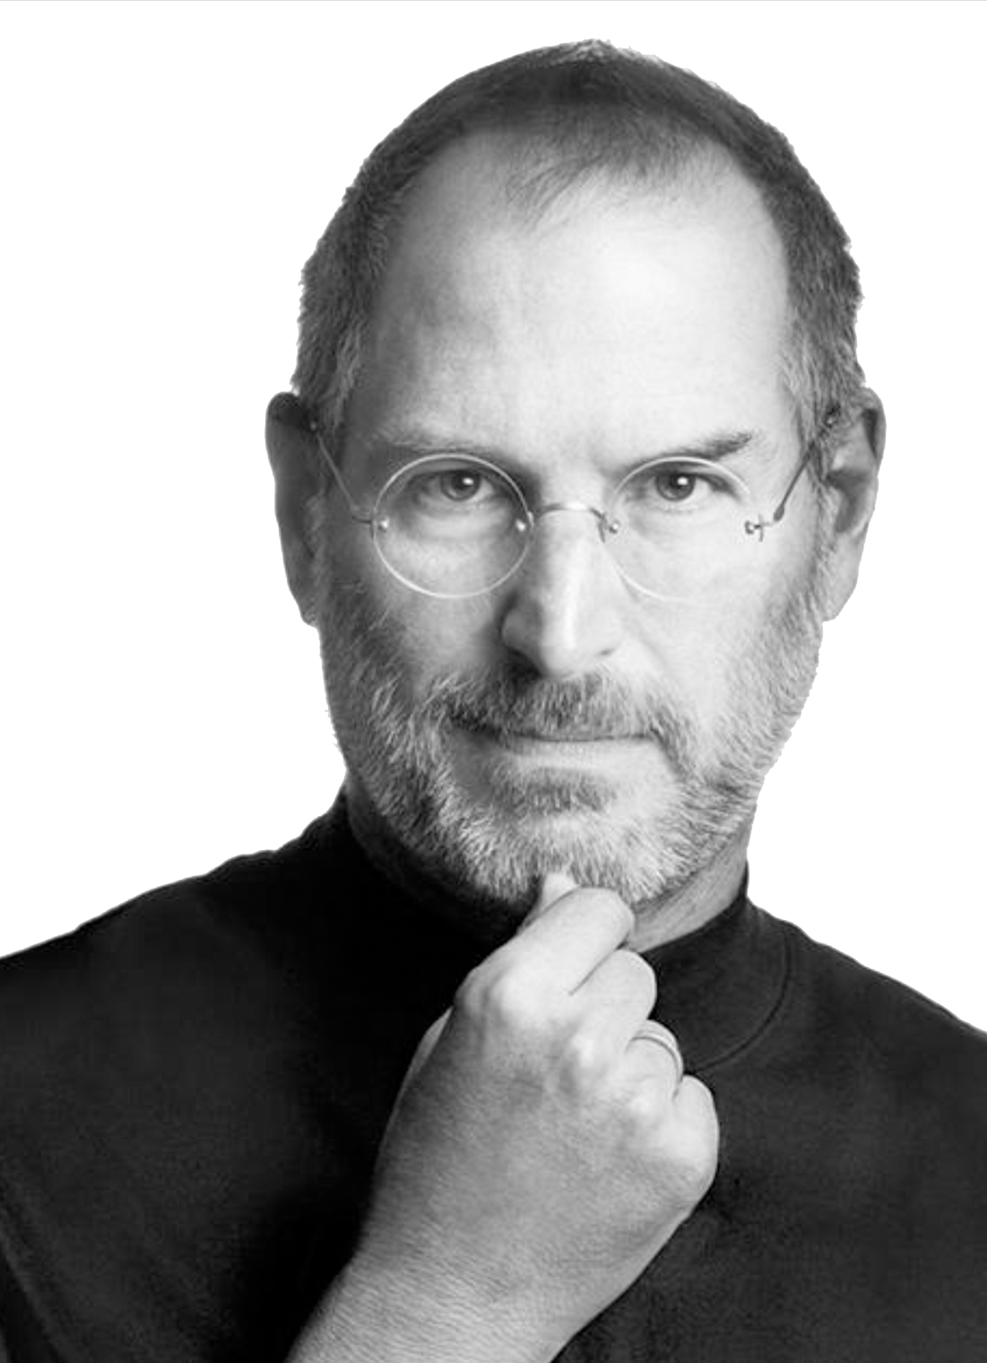
Who is this Entrepreneur?
1955-2011
Net Worth: $6.1 Billion
Industry: Computer Technology
Adopted by an average-income family
Had a hard time in school and got in trouble a lot
After high school one of his first jobs was at Atari
His innovations have changed our culture forever.
Steve Jobs

Slide 18
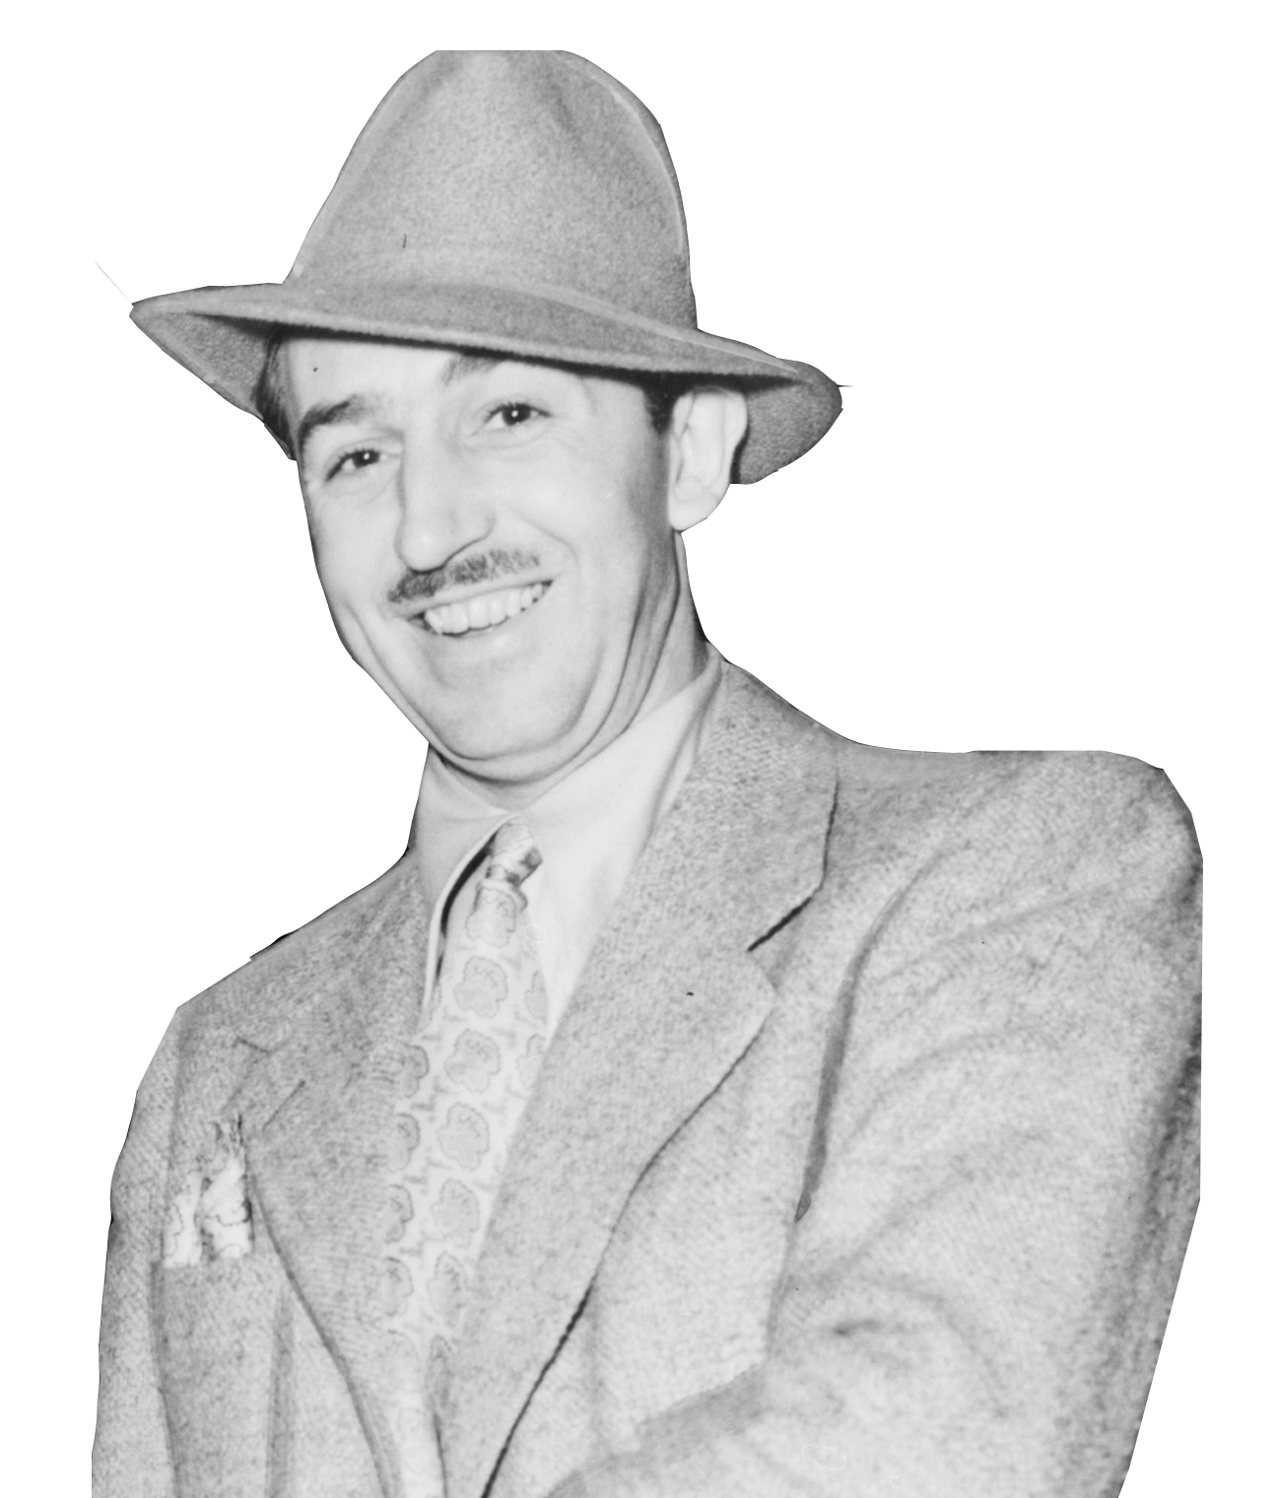
Who is this Entrepreneur?
1901-1966
Net Worth: $1.1 Billion
Industry: Entertainment
Not just an entrepreneur—he’s an ICON.
An artist and showman
His first two businesses failed—he was horrible with money
Was a pioneer in the animation industry
His business is now worth 74.9 Billion
Walt Disney

Slide 19
Types of Entrepreneurs
Notes:
During a discussion, have students make predictions to fill in traits of a successful entrepreneur.
Suggestions:
The ability to spot patterns and make a distinction between relevant and irrelevant data
The ability to make well-informed decisions based on limited information
Knowledge of your faults
Successful partnerships with people who complement your expertise
The humility to learn from mistakes
Survival skills
While distinctly different in nature, entrepreneurs and inventors are invariably dependent upon one other. There cannot be one without the other. Entrepreneurs are commonly recognized as the business minded individuals that improve upon an existing idea, innovating and adapting a product to a chosen market, while inventors, on the other hand, are credited for being the creators of an entirely new product or service. It is necessary for both to collaborate in order to obtain the success and financial rewards they both desire. http://blog.collegepro.com/small_business_advice/entrepreneurs-versus-inventors-minnesota/
Article called are you an inventor or an entrepreneur? http://blogs.hbr.org/cs/2009/06/are_you_an_inventor_or_an_entrepreneur.html

Slide 20
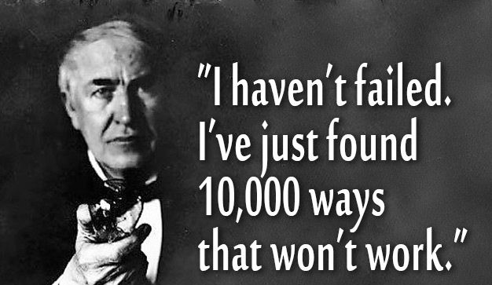
Inventor
Thomas Edison is a great example of someone who most people think of as an inventor because of the thousands of ideas he came up with. But when someone asked Edison about his ideas he replied that he didn't care about his ideas. The only ideas that were interesting to him were the ones that he could commercialize. "I am quite correctly described as more of a sponge than an inventor," he said. Yet most people in fact don't realize that the light bulb was not Edison's idea; he just commercialized it. Edison thought of himself as an entrepreneur.
Comes up with ideas for entirely new products and services
Thomas Edison
Lightbulbs, electricity, film and audio devices
Alexander Graham Bell
Telephone, telegraph
George Washington Carver
Agricultural chemist invented 300 uses for peanuts and hundreds more for soybeans, pecans and sweet potatoes
Eli Whitney
Cotton gin—separates seeds from the cotton
Johannes Guttenberg
The printing press
Benjamin Franklin
Lightning rod, iron furnace, bifocal glasses, odometer
Henry Ford
Assembly line, transmission mechanism, gas-powered car
James Naismith
Basketball
Nikola Tesla
Fluorescent lighting, induction motor, Tesla coil, 3-phase electricity
Notes:
Have your students identify what each person invented: (Here is some help).
The first great invention developed by Thomas Edison was the tin foil phonograph. A prolific producer, Edison is also know for his work with light bulbs, electricity, film and audio devices, and much more.
In 1876, at the age of 29, Alexander Graham Bell invented his telephone. Among one of his first innovations after the telephone was the "photophone," a device that enabled sound to be transmitted on a beam of light.
Eli Whitney invented the cotton gin in 1794. The cotton gin is a machine that separates seeds, hulls and other unwanted materials from cotton after it has been picked.
Benjamin Franklin invented the lightning rod, the iron furnace stove or 'Franklin Stove', bifocal glasses, and the odometer.
Henry Ford improved the "assembly line" for automobile manufacturing, received a patent for a transmission mechanism, and popularized the gas-powered car with the Model-T.
James Naismith was a Canadian physical education instructor who invented basketball in 1891.
Famous Utah Inventors http://inventors.about.com/od/americaninventors/qt/Utah.htm

Slide 21
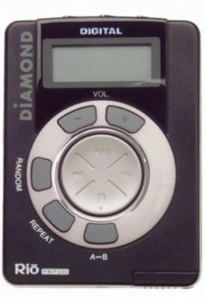
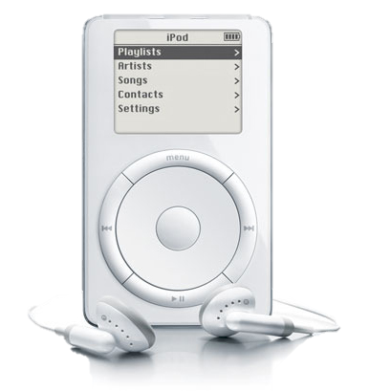
Innovator
Takes existing products or services and changes some aspect of them, such as features, size, or pricing
What is the difference between an INVENTION and an INNOVATION?
In its purest sense, “invention“ can be defined as the creation of a product or introduction of a process for the first time. “Innovation,” on the other hand, occurs if someone improves on or makes a significant contribution to an existing product, process or service.
What innovations can YOU think of?
Notes:
Have your students identify what each person invented: (Here is some help).
The first great invention developed by Thomas Edison was the tin foil phonograph. A prolific producer, Edison is also know for his work with light bulbs, electricity, film and audio devices, and much more.
In 1876, at the age of 29, Alexander Graham Bell invented his telephone. Among one of his first innovations after the telephone was the "photophone," a device that enabled sound to be transmitted on a beam of light.
Eli Whitney invented the cotton gin in 1794. The cotton gin is a machine that separates seeds, hulls and other unwanted materials from cotton after it has been picked.
Benjamin Franklin invented the lightning rod, the iron furnace stove or 'Franklin Stove', bifocal glasses, and the odometer.
Henry Ford improved the "assembly line" for automobile manufacturing, received a patent for a transmission mechanism, and popularized the gas-powered car with the Model-T.
James Naismith was a Canadian physical education instructor who invented basketball in 1891.
Famous Utah Inventors http://inventors.about.com/od/americaninventors/qt/Utah.htm

Slide 22
Marketer
They do not change the product itself, but rather the way the product is perceived by consumers.
Publicity stunts or clever marketing schemes have been used for years to attract customers, and can be seen as an entrepreneurial way of growing a company, gaining recognition and increasing sales—sometimes with very little cost. They can further a cause, a product, or an idea. They don’t always turn out good!
ProShade
Notes:
Have your students identify what each person invented: (Here is some help).
The first great invention developed by Thomas Edison was the tin foil phonograph. A prolific producer, Edison is also know for his work with light bulbs, electricity, film and audio devices, and much more.
In 1876, at the age of 29, Alexander Graham Bell invented his telephone. Among one of his first innovations after the telephone was the "photophone," a device that enabled sound to be transmitted on a beam of light.
Eli Whitney invented the cotton gin in 1794. The cotton gin is a machine that separates seeds, hulls and other unwanted materials from cotton after it has been picked.
Benjamin Franklin invented the lightning rod, the iron furnace stove or 'Franklin Stove', bifocal glasses, and the odometer.
Henry Ford improved the "assembly line" for automobile manufacturing, received a patent for a transmission mechanism, and popularized the gas-powered car with the Model-T.
James Naismith was a Canadian physical education instructor who invented basketball in 1891.
Famous Utah Inventors http://inventors.about.com/od/americaninventors/qt/Utah.htm

Slide 23
Marketer
They do not change the product itself, but rather the way the product is perceived by consumers.
Boston Tea Party – Samuel Adams and his group of American patriots threw 342 chests of tea into the Boston Harbor to pretest repressive taxation
Hands Across America -- On May 26, 1986 more than 6.5 million Americans, including then President Ronald Reagan, joined hands in a human chain across sixteen states to raise money for the hungry and homeless. Participants paid ten dollars each to participate, and the event raised $34 million for various charities.
Missouri-Kansas-Texas Railroad – In the 1880’s, this company staged a crash between two full size trains in Crush, Texas. 40,000 people flocked to the event, but a few people were killed when the boiler exploded!
The Blair Witch Project – In 1999, to create buzz for the horror flick The Blair Witch Project, the film makers gave out tapes to college campuses and presented them as real video diary footage. The Independent Film Channel also played clips that were labeled as documentary instead of fictional. This viral PR stunt created plenty of buzz for the film.
Taco Bell
Burger King
D.C. Comics
ProShade
Notes:
Have your students identify what each person invented: (Here is some help).
The first great invention developed by Thomas Edison was the tin foil phonograph. A prolific producer, Edison is also know for his work with light bulbs, electricity, film and audio devices, and much more.
In 1876, at the age of 29, Alexander Graham Bell invented his telephone. Among one of his first innovations after the telephone was the "photophone," a device that enabled sound to be transmitted on a beam of light.
Eli Whitney invented the cotton gin in 1794. The cotton gin is a machine that separates seeds, hulls and other unwanted materials from cotton after it has been picked.
Benjamin Franklin invented the lightning rod, the iron furnace stove or 'Franklin Stove', bifocal glasses, and the odometer.
Henry Ford improved the "assembly line" for automobile manufacturing, received a patent for a transmission mechanism, and popularized the gas-powered car with the Model-T.
James Naismith was a Canadian physical education instructor who invented basketball in 1891.
Famous Utah Inventors http://inventors.about.com/od/americaninventors/qt/Utah.htm

Slide 24
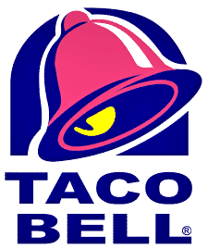
Taco Bell - 1996
The Stunt:
Thousands of people called in their complaints to the home of the Liberty Bell, the National Historic Park in Philadelphia, but by noon, Taco Bell admitted what many people suspected, since the day was, after all, April 1.
The Taco Bell ad was an April Fool's joke, and the media and public ate it up (no pun intended). More than 650 print media outlets and 400 broadcast outlets covered the prank, reaching more than 70 million Americans, according to Taco Bell's marketing department.
The company's revenue increased by $500,000 that day, and by $600,000 more the following day, compared to the previous week's sales.
Even then-White House spokesperson Mike McCurry, when asked about the Taco Liberty Bell, got inspired to reveal that the Lincoln Memorial had been sold and would from now on be known as the Ford Lincoln Mercury Memorial.

Slide 25
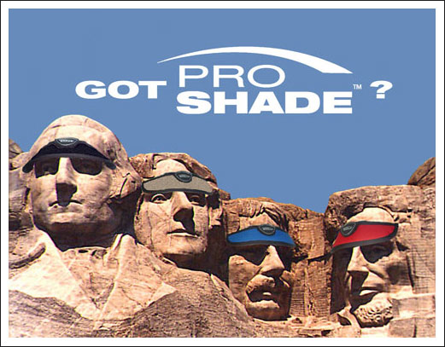
ProShade - 2006
The Stunt:
Proshade made an intriguing offer to the National Park Service when they proposed to give $4 million to Mount Rushmore in exchange for getting to put a logo visor on each of the presidents' heads.
Although the National Park Service didn't take them up on their offer and despite the fact that any decent journalist knew they were being taken, the company received a fair amount of publicity for their outlandish offer.

Slide 26
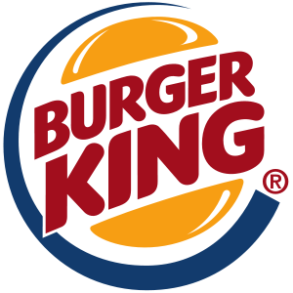
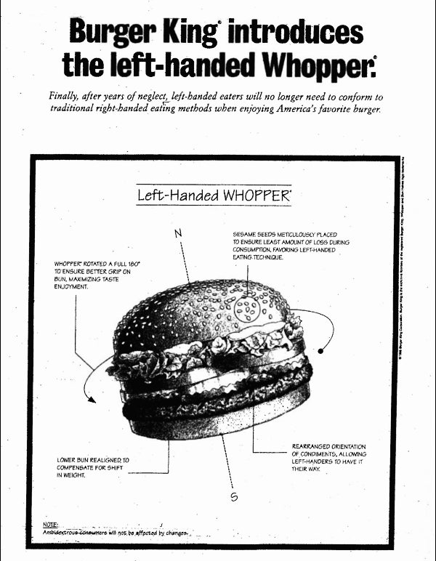
Burger King - 1998
The Stunt:
Burger King put out an ad in USA Today, stating that they'd re-engineered their most famous sandwich in order to benefit 32 million Americans, and now they were ready to present . . . the Left-Handed Whopper. They offered details of how the sandwich had been designed to fit more comfortably in the left hand, including rotating the condiments and redistributing the weight of the toppings.
This one didn't go over quite as well as they'd hoped, since some of those 32 million Americans came into the restaurant and were annoyed to discover they couldn't actually order the Left-Handed Whopper.
Still, there was no real backlash when the restaurant chain admitted it had been an April Fool's stunt, and since the ad brought in customers, including many who requested that they receive a right-handed burger, it should be called a success.

Slide 27
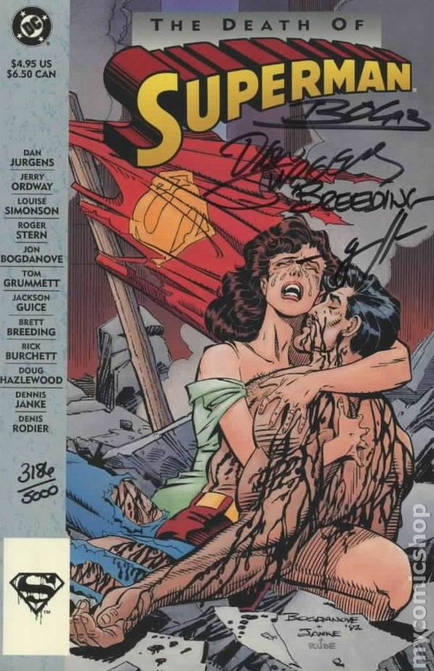
DC Comics- 1992
The Stunt:
Many people felt that releasing a comic book called The Death of Superman was a marketing stunt, given that nobody with half a brain really, truly thought this company was going to stop producing its most popular title, a hit since the Superman character was born in 1938.
The news media covered this development extensively, not quite as if a head of state had passed away, but seriously enough, and the comic book featuring his death sold out on the first day.
As more issues were published, they kept selling out. In fact, millions of readers purchased not just The Death of Supermanissue but numerous others that followed, including Funeral for a Friendand eventually--who would have guessed?--The Return of Superman.

Slide 28
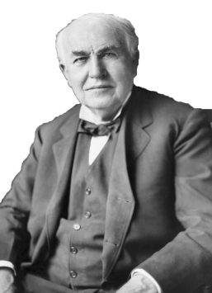
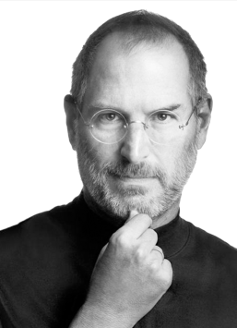
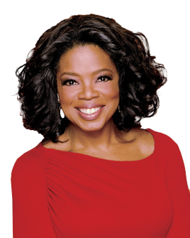
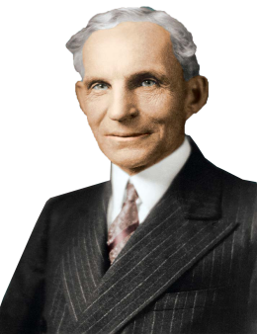
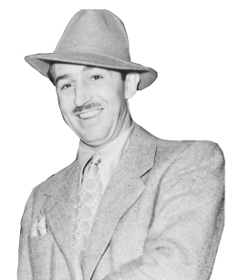
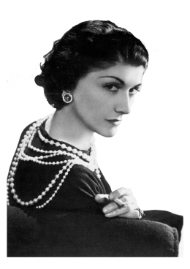
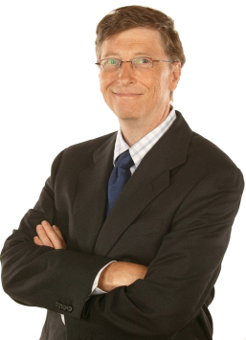
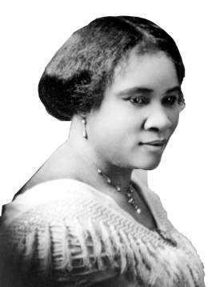
What kind of Entrepreneur are they?
Inventor
Innovator
Marketer

Slide 29
Traits of an Entrepreneur
Notes:
During a discussion, have students make predictions to fill in traits of a successful entrepreneur.
Suggestions:
The ability to spot patterns and make a distinction between relevant and irrelevant data
The ability to make well-informed decisions based on limited information
Knowledge of your faults
Successful partnerships with people who complement your expertise
The humility to learn from mistakes
Survival skills
While distinctly different in nature, entrepreneurs and inventors are invariably dependent upon one other. There cannot be one without the other. Entrepreneurs are commonly recognized as the business minded individuals that improve upon an existing idea, innovating and adapting a product to a chosen market, while inventors, on the other hand, are credited for being the creators of an entirely new product or service. It is necessary for both to collaborate in order to obtain the success and financial rewards they both desire. http://blog.collegepro.com/small_business_advice/entrepreneurs-versus-inventors-minnesota/
Article called are you an inventor or an entrepreneur? http://blogs.hbr.org/cs/2009/06/are_you_an_inventor_or_an_entrepreneur.html

Slide 30
Traits of an Entrepreneur
1. Full of determination
You have to be determined from the beginning to be successful -- before you even start. If you aren’t fully determined to make it there is a good chance you will crumble under the pressure.
2. Not afraid to take risks
Many would assume it isn’t possible to start a business with very little money, but those who aren’t afraid to take risks don’t see things such as limited funding as a handicap.

Slide 31
10 Traits of an Entrepreneur
3. High Level of Confidence
Big challenges breed big rewards. This is the same mentality that allows successful entrepreneurs to spot an opportunity when most just see a possible challenge. When most focus on the challenge, a successful entrepreneur focuses on the finish line and the end reward.
4. Craves learning
Staying sharp, through constant learning, will enable you to stay ahead and avoid getting passed. Read books and wake up earlier in the morning to read industry news -- do everything you can to constantly learn and absorb new information.

Slide 32
Traits of an Entrepreneur
5. Understands failure is part of the game
If you understand that failure is part of being an entrepreneur, you will take those failures and use them as learning experiences. Real world experience, even failing, will teach you more than you would ever learn in a classroom.
6. Passionate about their business
You have to thoroughly enjoy what you are doing -- there will be long days and nights and at some points along the way your business will consume you. If you aren’t fully passionate about what you are doing the added stress and obstacles will build up on your shoulders and eventually be responsible for your collapse.

Slide 33
Traits of an Entrepreneur
7. Highly Adaptable
If you are extremely adaptable it gives you the ability to respond quickly in any situation. This allows you to make decisions that will navigate you out of trouble and allow you to thrive in environments that would sink those that aren’t adaptable.
8. Good understanding of money management
Have a clear financial map drawn out. Stick to your plan and make sure all founders and shareholders are on the same page. Money problems can destroy a business the same way they can ruin a marriage.

Slide 34
Traits of an Entrepreneur
9. Expert at Networking
Building value-based relationships that are truly meaningful is what networking is all about -- these are the relationships that lead to business opportunities and long-term relationships that are mutually beneficial. You should always know how you can help someone and provide value to them before even thinking about how the relationship will be potentially beneficial to you.
10. Ability to sell and promote
Knowing how to sell is an absolutely essential part of being a successful business owner. If you can’t express what it is that makes your product or service a solution to a problem, you will be in for a rough ride. If you, the creator, can’t explain it, then who will?

Slide 35
Are YOU an Entrepreneur?

