Slide 1
Staycation
Project

Slide 2
Group assignments and new seating chart
Project Overview
Skill inventory
Choose Your Destination
Ad Type Overview
Choose Ad Types
Assign Jobs
Day 1

Slide 3
Overview
You will be assigned in groups of 3 or 4
You will form a Travel Company with a name, slogan and logo
You will create an ad campaign targeted at Utahns for a specific location in Utah.
You will create 3 ads, choosing from a list of 7 different types of ads.
You will present your best ad to the class
You will be graded on your packet, your ads, your presentation, and a group evaluation
You will received CTE Cash based on which ads you complete, your score on each ad, and your group evaluation

Slide 4
Pay vs. Points
There are TWO parts to this—Pay and Points
You will be given points for completing the assignments required. More effort will be given more points.
You will be given MONEY according to which ad types you chose—some pay more than others—and how good a job you did on each
There is also an element in both grades and money for your own personal evaluation.

Slide 5
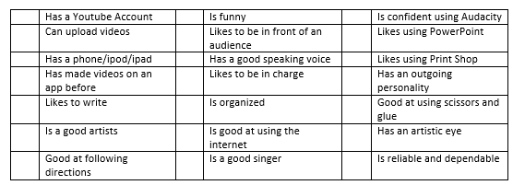
Skill Inventory
Take a moment to fill out the Skill Inventory page together. This will help you determine the strengths and weaknesses of your group and what prior knowledge you already have.
This will make it easier to choose ad types that your group will excel at.

Slide 6
Choose your Destination
Lake Powell
Bear Lake
Salt Lake City
Provo
Zions/Bryce
Cedar City
Flaming Gorge
Capitol Reef
Monument Valley/4 Corners
St. George
Park City
Vernal
Canyonlands/Moab
Arches
Ski Resorts
Grand Staircase Escalante
Goblin Valley
Logan
Bears Ears
Kanab
San Rafael County
Castle Country

Slide 7
Billboard
Half sheet of poster board, provided by Mrs. Rees
Include Destination, pictures, and text.
You may use the Silhouette machine to cut out your lettering

Slide 8
PowerPoint Ad
Create a video in PowerPoint
5 slides, add images, music, and words to advertise your location on the 5 slides.
Set it to automatic, then save as a SHOW file. It will play like a video.
Example

Slide 9
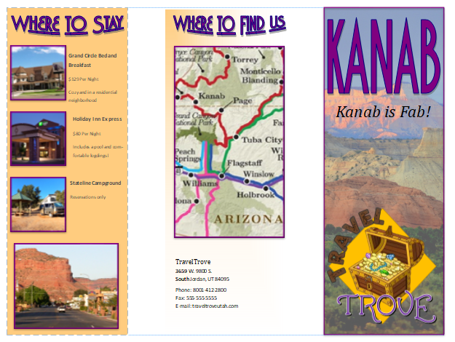
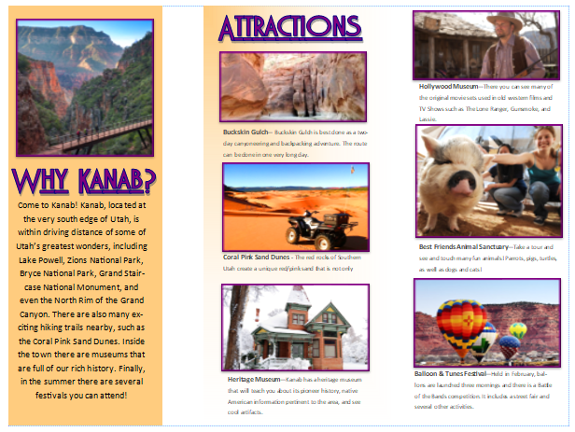
Brochure
Two-sided, three panel page.
Use Brochures in Publisher
Must include graphics and lots of text
Includes info on hotels, flights, restaurants, attractions, etc.
A template in Publisher is provided, as well as a step-by-step video that will help you create your brochure.

Slide 10
Radio Ad
Write up the commercial—should be about 30 seconds long
Record using your phone—androids are best. There are many free apps you can use
You will want to find a quiet place to record.
You may use Audacity to edit it and add sound effects if you wish.
Example

Slide 11
Flyer
Flyers are the easiest one to create, so they have the smallest payout
Use Print Shop, Tall Blank Page
Include destination name, slogan, essential points, logo, and images.

Slide 12
Website
Create a website using Weebly.
Login and password is on the front page of your packet
Your website WILL be live on the internet!
Include three additional pages for attractions, contact information, and maps.
Example

Slide 13
TV Ad
Film with your cell phone, or you can borrow my flip camera—I only have one.
Edit it if you wish with the free video editing app of your choice
Must be at least 30 seconds long
You can film it in class, outside, in the hall, in an empty classroom, or you can film it at home.

Slide 14
Youtube Ad
You must have a youtube account and you must have it actually uploaded to youtube in order for it to count
It must be at 1-3 minutes long
Example

Slide 15
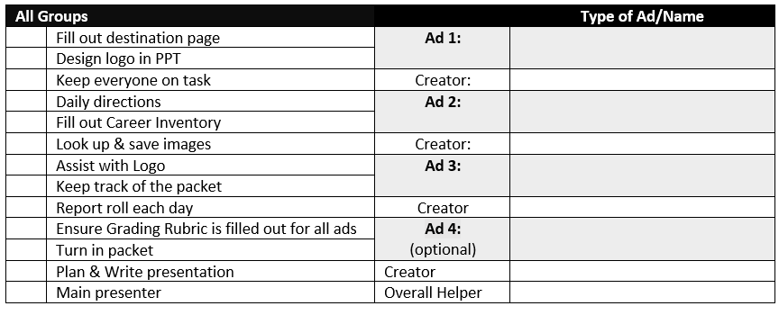
Assign Jobs
In your packet, there is a list of jobs. Initial what you will take on as your responsibility. In the colored section, only initial the sections for the ads that you chose.
All required boxes should be signed for!
MS
JJ
Billboard
ST
Maryann Smith
IR
Radio Ad
IR
MS
Jessica Jones
IR
Website
JJ
JJ
Isabelle Rodrigues
JJ
Flyer
MS
ST
Stephanie Taylor
ST

Slide 16
Schedule
Day | Activities
Day 1 | Intro, choose location, seating chart, choose jobs
Day 2 | Create a logo, Slogan, and company name
Days 3-7 | Design Ads
Day 8 | Presentations
Day 9 | Group Evaluation
Day 10 | Auction
Company

Slide 17
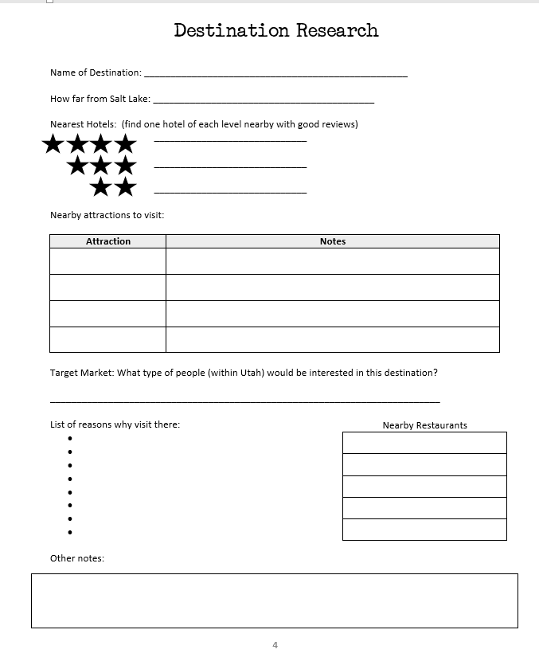
Know Your COmpany
Choose a name
Invent a slogan
Create a logo
Fill out the Destination Research Page
Day 2

Slide 18
How to Create a Logo
Design the logo in PowerPoint using images, WordArt, and shapes
You may use images from the internet or copy and paste clipart from Print Shop
Do not use copyrighted works like already designed logos, characters from video games or movies, etc.
Save as a .jpg image
When finished, press CTRL+A to highlight all pieces, then, with your cursor as a four-sided arrow, hovering over the images, right click and choose “Save as Image.”
Save the file. Go to Insert>Image and pull it back in.
Print the image
Resize the image to a quarter of the page and print in color.
Cut it out and glue it into your packet.

Slide 19
Day 3-5 – Advertising Production
Begin ad production
Try to get one ad done a day!
All needed supplies for billboards, etc, will be on the back table. Please keep the glue and scissors on that table
Come see me if you want me to cut out lettering for you
Let me know if you are going to film. You may film in the hall, outside, and possibly next door if the room is empty.
Day 3-5

Slide 20
Day 6 – Plan Presentation
Plan Presenation
Career Inventory
Personal Inventory
Day 6

Slide 21
Plan Presentation
Plan out your presentation using the page in your packet.
Your presentation must include:
An attention getter
Greet the audience
Introduce subject
Show your Ad – just show one
Conclude
You will be graded on:
Preparation – You have filled out the page and clearly prepared beforehand
Attention – You got the attention of the audience
Audience – Audience participation in your presentation

Slide 22
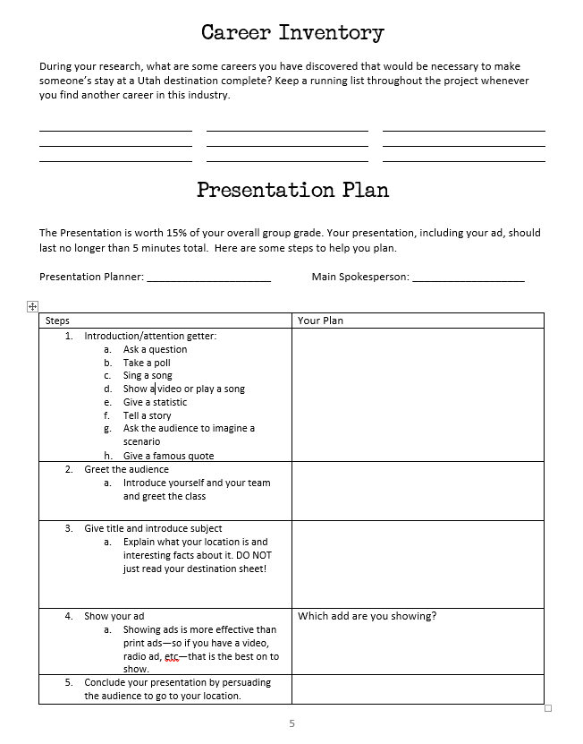
Career & Personal Inventory
Career Inventory page
List as many careers as you can think of or find online that are affected by someone taking a staycation to your destination
Personal Evaluation
Fill out the questions for the personal inventory. Not doing so can affect your INDIVIDUAL grade, not your group grade.
The more you write, the better your score!

Slide 23
Day 7 – Presentations
You have 3 minutes to present your ad
Introduce your location
Introduce team members and their jobs
Show your ad to the class
Finish your skills sheet
Turn in your packet
Day 7

Slide 24
Day 8 – Group Evaluation
Open up your Group Evaluation in the CCA folder. Make sure you only choose YOUR team.
Only look at YOUR page.
Enter a score of 0-4 for each question, for each person
Yes, you need to fill out an evaluation for yourself
0’s can make a huge negative impact on grades. Do not mark someone that low unless you are prepared to defend it to me. I may talk to you about it.
4’s are excellence—don’t hand them out unless they truly earned it!
ANSWER THE QUESTIONS. This is not asking if you liked them or not. Did they do their job? Be fair. Be honest.
When finished, just close the file.
Day 8

