Slide 1
Electronic Communication
By Megan Rees

Slide 2
Types of Electronic Communication
1. E-mail
2. Cell Phones
3. Blogs
5. Teleconferencing
6. Skype
4. Podcasts
7. Chat Rooms
8. Social Networks
Situation Quiz

Slide 3
Email
Definition: Messages distributed by electronic means from one computer user to one or more recipients via a network.
Pros
Quick way to send documents and images
Leaves a paper trail
“Conversations” can be easily browsed
Free to set up
Cons
Spam has never been satisfactorily dealt with
Replies depend on how often email is checked
Viruses often are sent this way
Limited amount of space to send information

Slide 4
Email
Look up the terms listed on your worksheet. Not all of these below are on it.
Parts
  To
  Subject
  CC and BCC
  Send
  Reply
  Forward
Common Problems
Terms:
  Spam
  Attachments
  Netiquette
  Domain
Email Activity

Slide 5
E-mail Safety
Email Safety tips
  Only give your email address to people you know and trust, not people you have met online
  Don’t give away anything about your last name, location, etc in your email address
  Keep records—if someone is bullying you or harassing you via email, keep it all and don’t delete it
  Have more than one account—have a personal account for friends and family, and other accounts for school, work, or purchasing goods online
  Never open attachments from people you don’t know—they could contain viruses or just unsavory images or text you don’t want to see
  Don’t click on any links in spam – This makes you vulnerable to viruses and can send you to places you don’t want to be
  Choose an email account that is difficult to guess; a series of number and letters

Slide 6
E-mail
Common Problems with E-mail:
Delivery failure
Junk mail
Viruses
Fraud
Watch the Video

Slide 7
E-mail Activity/Assignment
Open you JSD Google account
  Go to Google.com
  Login: Your classroom computer login@my.jordandistrict.net
  Password: Student number
    If this is your first time logging in, it will prompt you to change your password. It will require an eight character password, but your student number is only seven characters
    Type your student number followed by your first initial as your new password.
    Within 24 hours, your password should automatically reset to your student number again.

Slide 8
Email Activity/Assignment
Create the following email:
  To: Anyone in this class – Type in their name to get their email to come up
  CC to TEACHER E-MAIL HERE
  BCC to another person in this class
  Subject: My teacher is awesome.
  Content: Type up a short statement explaining why your teahcer is awesome.
  Attachment: Attach a file to this document. It doesn’t really matter what it is, but do not choose a power point or an image file.
  Send the email.
  When you receive one from your classmate, REPLY to their email.

Slide 9
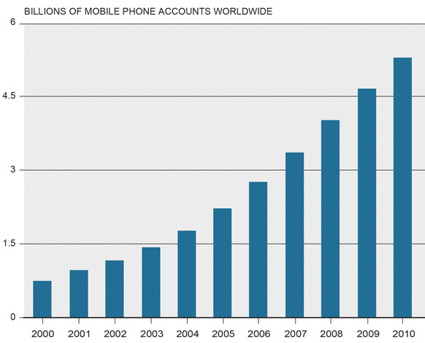
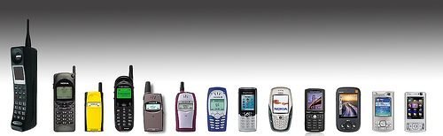
Cell Phones
First cell phone was demonstrated in 1973, and weight 2.2 lbs.
First commercially available cell phones came out in 1983.
From 1990 to 2011 mobile phone subscriptions grew rapidly
Cell phones are the most common form of electronic communication
  Tweeting
  Texting
  Messaging
  Social Media, etc

Slide 10
Cell Phones
Pros
Easy, quick, and accessible
Cheap—even the simplest phones have the capability for some form of electronic communication
Can use your cell phone like a computer to send instant messages
Cell phones are the gateway to many forms of electronic communication—a smart phone is capable of doing nearly all the types in this power point.
Cons
Can’t hear the tone of voice that comments were said in
Can be time consuming to type
Typing errors easily made
Is eroding our language
In 2011, 23% of auto accidents involved cell phones
Low security—anyone with your phone can send a text
Used for bullying, sexting, and other crimes
Texting
Instant Messaging
Twitter

Slide 11

Texting
Definition: The act of typing and sending brief, electronic message between two or more mobile phones or fixed portable devices over a phone network.
  Does not require that users have the same provider

Slide 12
Texting Safety
Do not text and drive
Keep your cell phone hidden—theft is common
Never reply to a text message from someone you don’t know. Know how to block others from calling your phone
Be careful meeting someone in person that you met through texting
Be nice! Texting makes a record that can be sent and resent to others. Also your tone of voice cannot be detected so your words can be taken the wrong way
Be careful what pictures you send—they can also be resent. They can also get you into trouble at home and at school.

Slide 13

Texting Activity
Pull out your phone. If you don’t have one, you will have to borrow someone else’s in the class.
Text to the following number:
TEACHER: ENTER YOUR INFO!
Enter this message:
  TEACHER: ENTER YOUR INFO!
  It will prompt you to send in your name
  You have now been subscribed to my class in Remind 101. I can send you text messages. I will check to see that you are added to the class list in my login in order to get points for this activity.

Slide 14
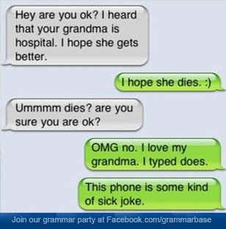
Instant Messaging
Definition: A type of communications service that enables you to create a kind of private chat room with another individual in order to communicate in real time over the internet. Similar to a telephone conversation but text-based, not voice based.
What is the difference between texting and IM’ing?
Networks – Texting uses a cellular service. Instant Messaging uses a website—does not need a phone
Accessibility – Texting can be done between any two cell phones who pay for the service. With IM, both users must have an account with the same service
Transmission costs – Texting is paid for with your cell service. IM is free on the computer, but a data plan is required on a cell phone
Security - IM requires a user name and password

Slide 15
Instant Messaging Safety
Never open pictures, download files, or click links in messages from people you don't know. If they come from someone you do know, confirm with the sender that the message (and its attachments) is trustworthy. If it's not, close the instant message.
Be careful when you create a screen name. Each IM program asks you to create a screen name, which is similar to an e-mail address. Your screen name should not provide or allude to personal information.
Create a barrier against unwanted instant messaging. Do not list your screen name or e-mail address in public areas (such as large Internet directories or online community profiles) or give them to strangers.
Never provide sensitive personal information, such as your credit card numbers or passwords, in an IM conversation.
Block unwanted messages. Most IM programs allow you to build a contact list (also known as a "buddy list"), which is similar to the address book in your e-mail program.
Don't send personal or private instant messages at work. Your employer might have a right to view those messages.
If you use a public computer, do not log on automatically. If you do, people who use that computer after you can see and use your screen name to log on.
When you're not available to receive messages, be careful how you display this information to other users. For example, you might not want everyone on your contact list to know that you're "Out to Lunch."

Slide 16

Twitter
Definition: A service that enables senders to read “tweets,” which are text messages limited to 140 characters. Registered users can read and post. Unregistered users can only read them.
  Accessed through the website, SMS, or a mobile device app
  “With Twitter, it wasn't clear what it was. They called it a social network, they called it microblogging, but it was hard to define, because it didn't replace anything. There was this path of discovery with something like that, where over time you figure out what it is. Twitter actually changed from what we thought it was in the beginning, which we described as status updates and a social utility. It is that, in part, but the insight we eventually came to was Twitter was really more of an information network than it is a social network.” ~ Evan Williams, creator

Slide 17

Blogs
Definition: personal website or web page on which an individual records opinions, links to other sites, etc. on a regular basis.
  Free to create
  Easy to create, even if you have little to no knowledge of web design
  Generally appear in reverse chronological order, each post is by date
  Generally operated by one user, and is about one specific topic
    Cooking, Mommy blogs, craft blogs, Do It Yourself blogs, Art, Photography, etc
  Interactive—visitors can become “followers” and leave comments
  Can add advertising. Blogs with high traffic can generate a lot of money for the blog owner

Slide 18
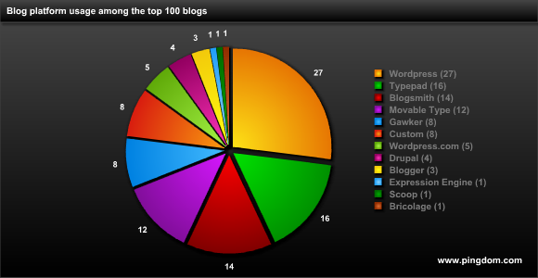
Blogs
Blogging is free. There are many platforms that can be used. If you are using the free version, your blog will have that platform’s name in the URL. If it is an upgraded pay version, the URL will just be the name and .com.
Popular blog platforms:
  Wordpress
  Blogger
  Typepad
  Blogsmith
  Movable
  Gawker
  Drupal
  MANY others!

Slide 19
Blogging Activity
Do a search online and find a blog for each of the following categories:
  Photography
  Art
  Music
  Reading
  Do It Yourself
  Cooking
Write down your answers in your packet.

Slide 20

Podcasts
Definition: A multimedia digital file made available on the Internet for downloading to a portable media player, computer, etc.
Generally come in episodes that you download.
  If you subscribe, new episodes will be downloaded automatically
  Most podcasts are free. Can be found in the iTunes store
Popular podcasts include
  Ted Talks
  The American Life
  NPR: Wait Wait…Don’t Tell Me
  Freakonomics Radio
  Stuff you should know

Slide 21
Teleconferencing
Definition: A conference of people who are in different locations that is made possible by the use of such telecommunications equipment as closed-circuit television
  Audio
  Telephone
  Video
  Internet
Generally used in a business setting
May have more than two communication points
Watch the Video

Slide 22

Skype
Definition: Have a spoken conversation with (someone) over the Internet using the software application Skype, frequently also viewing by webcam.
  Generally used in a personal setting, and with only two communication points.
  It is also a downloadable app
  Calling through Skype is free of charge
    A great way to communicate with people overseas
  Can be used for video conferencing

Slide 23
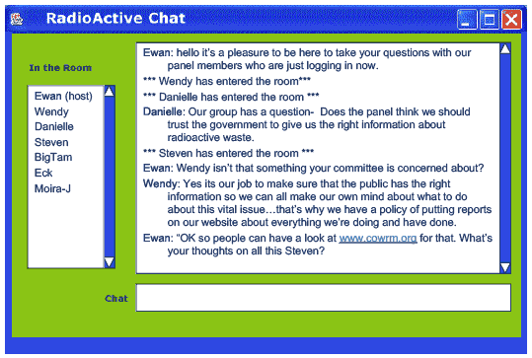
Chat Rooms
Purpose: To share information via text with a group of users
Different from instant messaging because it caters to a group of people rather than one-on-one
Users are generally connected by a shared interest
Chat rooms are very common in gaming
Chatting is also great in school settings for collaborating on homework. Google Drive has a chat option.
Rules – Chat rooms usually have strict behavior rules

Slide 24
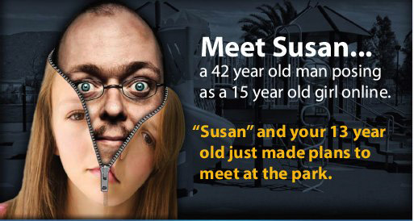
Chat Room Safety Tips
Chat rooms, where many people gather for live interaction, are among the riskiest place on the Net—where kids are more likely to “talk” with strangers about inappropriate topics.
Remember that what you say in a chat room or instant messaging session is live – you can’t take it back or delete it later.
Don’t say anything you wouldn’t want the public to know – this includes your full name, your address, phone number or other personal information.
Don’t get together with someone you meet in a chat room. If you must, meet in a public place and bring along some friends.
Don’t reveal your actual location or when and where you plan to hang out.
Choose a nickname that’s not sexually suggestive and doesn’t give away your real name.
If someone says or does something creepy, block them and don’t respond
Just sign out if the topic turns to sex. That can often lead somewhere you don’t want to go.
It’s easy to say things in a chat room you would never say to someone’s face. Be careful—this behavior can give the wrong impression about who you are and what you will do. This wrong impression could even be fatal.

Slide 25
Social Networks
Definition: A dedicated website or other application that enables users to communicate with each other by posting information, comments, messages, images, etc.
  Facebook
  Twitter
  My Space
  LinkedIn
  Google+
  Friendster
  Pinterest
  Classmates
  Tagged
  myYearbook
  Twitter
  Flixster
  MANY more!
Go to my website and take a poll on which social networks you use!
Take the Poll!
TEACHER: You may click on this link to see my poll, but you will probably want to make your own or delete it entirely.

Slide 26
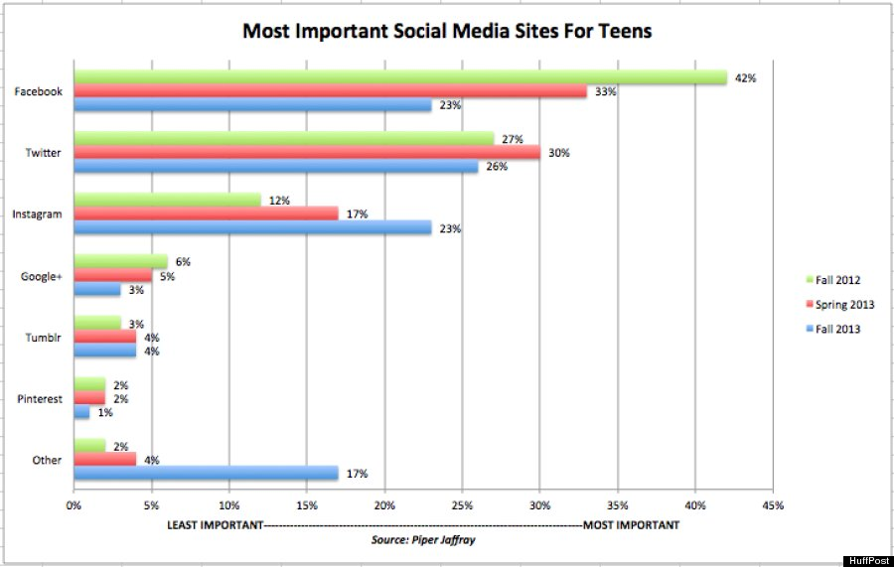
Social Media
Use this graph to answer the questions in your workbook.

Slide 27
Safety – Social Media
In all electronic communication, it is imperative that you exercise caution, judgment, and safety procedures
Watch the Video
In the
workplace

Slide 28
Social Network Activity
Effects on Society
  Do a search on the internet for an article about the effects of social networks on youth
    Pay attention to your source—is it credible?
      Look for articles, not forums or knowledge bases
    As you choose your article and read it, determine how valid this article is.
      How does the writer KNOW this? Are they siting any sources? Is it opinion or is it backed up by fact?
    What type of website did you get it from?
      Is it a personal blog, or an official educational site? Is the information fact or opinion?
    Do an advanced search to narrow it down (Read more here)
  Once you have found a credible article, read it and follow the directions on your workbook.

Slide 29
Advanced Search
Do an advanced search so that you are only searching for RECENT articles
In Google, after you have entered your search terms, click on the gear button in the upper right corner and choose Advanced Search.
Under “last update” choose Past week, past month, or past year. Now only recent articles will appear
You could also change the file type to .pdf—you may get a more reliable source this way.

Slide 30
Situation Quiz
Can you identify which of all the electronic communications types would be best for the following situations? Refer to your packet for a list of all possible answers.
1
2
3
4
5
6
7
8
9
10
End Show

Slide 31
Question 1
Situation:
You would like to write a lot about a topic that you find really interesting. You want to connect to other people who are also interested in that topic. But the most important thing to you is WRITING. You want to share you knowledge with the world!
Podcast
Blog
Chat Room
Facebook

Slide 32
Question 2
Situation:
You are at work and need to speak to the regional office managers in you Paris office and you New York office, at the same time.
Social Media
Twitter
Chat Room
Teleconferencing

Slide 33
Question 3
Situation:
You have a series of lectures about a topic you love that you would like to share with the world. You want to make actual videos of yourself talking about these subjects.
Podcast
Email
Teleconferencing
Blog

Slide 34
Question 4
Situation:
You are working out a problem with another company at work, and want to make sure everything that is said is in writing and can be traced. You also want to keep a good record of the dates and times these communications were sent.
Email
Texting
Skype
Teleconferencing

Slide 35
Question 5
Situation:
You need to send a quick message to your co-worker to let them know you are going to be late that morning.
Facebook
Blog
Instant Message
Chat Room

Slide 36
Question 6
Situation:
Your friend lives in Japan and you want to talk to them for free! What is the best way to have full communication?
Instant Message
Twitter
Podcast
Skype

Slide 37
Question 7
Situation:
You want to share your feelings on a subject with your friends and family all at once.
Texting
Facebook
Twitter
Pinterest

Slide 38
Question 8
Situation:
You would like to discuss your class assignment with some of your classmates, all at the same time.
Facebook
Podcast
Chat Room
Email

Slide 39
Question 9
Situation:
You want to talk to your mother, brother, and sister who all live in different states, all at the same time. You would like to see their faces as you make a big announcement!
Skype
Facebook
Texting
Instant Message

Slide 40
Question 10
Situation:
You are watching a news program and have very strong opinions about what is happening in the world, and you wonder what other people think about it. You want to share, quickly, your thoughts, and also know theirs.
Twitter
Instant Message
Podcast
Chat Room

Slide 41
Correct!

Slide 42
Incorrect!
Try Again!

