Slide 1
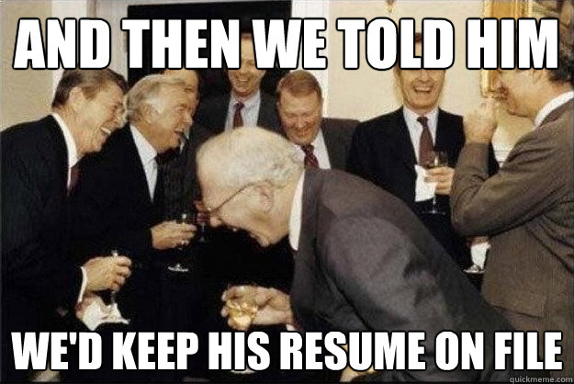
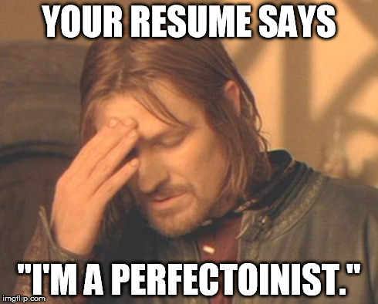
Creating a Résumé
By Megan Rees

Slide 2
What is a résumé?
A brief document that summarizes your education, employment history, and experiences that are relevant to your qualifications for a particular job for which you are applying. The purpose of a résumé (along with your cover letter) is to get an interview.

Slide 3
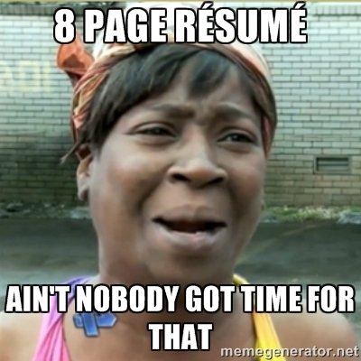
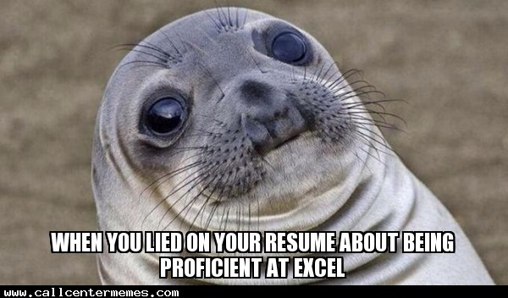
Basic Resume Rules
Brevity
Keep it to one page unless you have many years of experience
You can do a second page for references
Simple and professional
Avoid obnoxious fonts, borders, and paper.
Use no more than two fonts
Do not use images or underline
Do not include a picture of yourself
Underlining is discouraged, as it can get confusing with hyperlinks if the resume is online.
No spelling errors or typos
Any typos will probably get your resume thrown away before it is even read!
Truthful
Never lie on your resume. It can come back to haunt you and it is illegal!

Slide 4
What NOT to do…
Here are some items actually found on resumes by hiring managers, according to careerbuilder.com:
Candidate mentioned in his resume that he spent summers on his family’s yacht in Grand Cayman.
Candidate attached a letter from his mother.
Candidate used pale blue paper with teddy bears around the border.
Candidate explained a gap in employment by saying he was getting over the death of his cat for three months.
Candidate included a picture of herself in a cheerleading uniform.
Candidate drew a picture of a car on the outside of the envelope and said it was the hiring manager's gift.
Candidate’s hobbies included sitting on a levee at night watching alligators.
Candidate included the fact that her sister once won a strawberry-eating contest.
Candidate explained an arrest by stating, “We stole a pig, but it was a really small pig.”
Candidate included a family medical history.

Slide 5
What goes on a resume?
Name and Contact Info
Profile/Objective
Skills & Abilities
Education
Selected Achievements
Volunteer Work
Awards
Experience
References

Slide 6
What does NOT go on a resume?
Private matters such as age, religion, sexual orientation, marital status, whether you have children or your medical issues
Unprofessional contact information – use email addresses that are professional
Attention getting tactics like perfumed paper, unusual fonts, different ink colors, etc.

Slide 7
Name and Contact Info
First and Last name, Middle initial if you have one
Address – Either the full address or just the city and state you live in
Phone number – use the number you answer the most
Email address (optional)
You may use no more than 2 fonts
You may use simple borders, horizontal lines, symbols or text boxes.

Slide 8
Profile/Objective
Objective: Defines your goal as employee and in your career.
Considered outdated, and not used as often.
Often specific to the job you are applying for.
“I am seeking a position in the web design industry, focusing on coding and design.”
Profile: Gives you the opportunity to present your strengths at the beginning of a resume.
Considered to be a more professional route, but much more difficult to write
Lets you put your strengths right at the top for immediate notice.

Slide 9
Writing a Profile Statement
Includes:
Character traits
Experience
Education
Areas of special knowledge
“Young, dynamic student seeking a career in the business world. Currently attending college, majoring in Business Management and a minor in Marketing. Resourceful and knowledgeable about computers—but software and hardware. Excellent common sense and decision making skills. A quick learner and detail oriented. Self-motivated and hard working. Enjoys learning new things and good at taking direction.”

Slide 10
Education
Place experience before education if you have more than 5 years of related experience. Otherwise, put your education first.
List your GPA if it is a 3.0 or higher
Include academic honors to show you excelled in your program
Related Coursework – you can list classes or projects you have completed if they relate to the job.

Slide 11
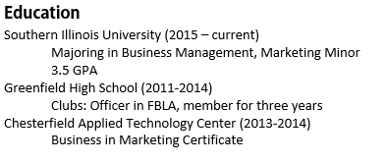
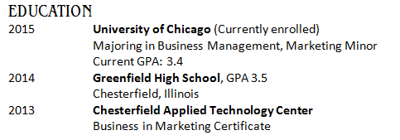
Education

Slide 12
Skills & Abilities
Where you can list any useful skills and abilities that are not already mentioned in the other areas.
Relevancy – Keep your skills targeted to the job you are applying for.
Be Specific – Instead of “skilled typist,” say “70 wpm typist”
Organize your bullets – Keep your skill types together

Slide 13
Skills & Abilities
Hard Skills
Soft Skills
Word processing
Computer programming
Spanish fluency
Advanced bookkeeping
Schedule management
Mathematics
Automotive Repair
Typing Speed
Problem solving
Adaptability
Collaboration
Strong work ethic
Time management
Critical thinking
Self-Confidence
Handling pressure
Leadership
Creativity

Slide 14
Selected Achievements
In this area you can include your achievements. You can divide it into awards and volunteer work, or put them all in one section, depending on how much you have.
Team awards for sports and dance groups, etc are not what they are looking for!

Slide 15
Examples of Achievements
Managed a team
Stayed in budget
Got promoted
Trained employees
Held a leadership position
Attained a certification
Featured in a website/magazine/etc
Perfect attendance record
Met deadlines consistently
Finished in top percentile for class/course
Achieved company goals

Slide 16
Examples of Volunteer Work
Community service
If you volunteered for a longer period of time, you can include it in your work history, even if it was unpaid.
Volunteer work is a GREAT way to beef up your resume when you are young with little experience!

Slide 17
Awards
It’s a good idea to include a brief explanation of what the award means and who presented it
Don’t go too far back in your past. As you get older, some of your older awards should drop off the list.

Slide 18
Awards
Scholarships
Academic awards
Leadership positions
Work-related honors and awards
Honor roll inclusion for high grades
Awards for specific activities or subjects

Slide 19
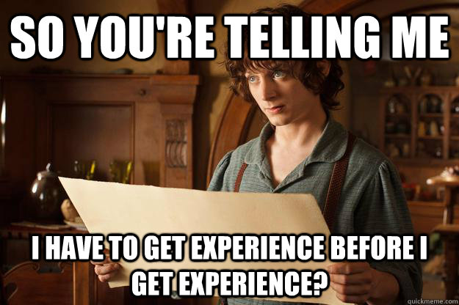
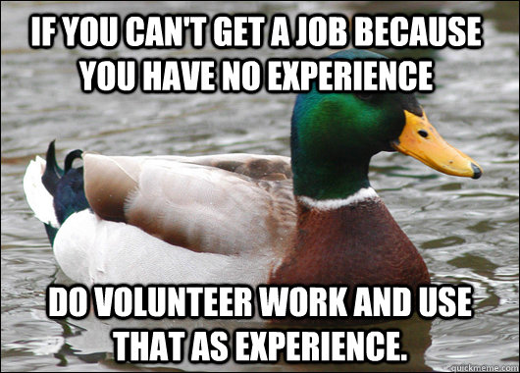
Related Experience
Work does not have to be paid to be considered work experience.
Work experience
Professional experience
Work History
Field work
Volunteer work
Relevant Experience

Slide 20
Related Experience
Information to Include:
Company or organization
Position title
Dates of employment or involvement
Descriptions of responsibilities and duties.

Slide 21
Related Experience

Slide 22
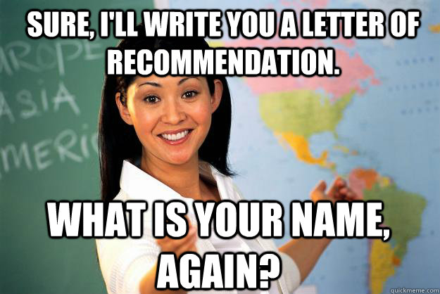
References
Contact your references in advance and ask permission to list them as a reference.
Attach your references on a separate sheet entitled “references” or at the bottom of your resume.
Provide full name, business address, occupation, phone number, and email.

Slide 23
References
Choose references who can provide examples of your hard work, effectiveness, and personality.
They need to know you well enough to give you a glowing review!

Slide 24
References
Who NOT to choose:
Who to choose:
Parents
Relatives
Friends
Co-workers
Former employers
Teachers/coaches
Ecclesiastical leaders
Supervisors

