Slide 1
Updated March, 2019
By Megan Rees

Slide 2
Marketing Trivia
Logos
Miscellaneous
General Marketing
Slogans
Jingles

Slide 3
General Marketing
1
2
3
4
5
6
7
8
9

Slide 4
General Marketing #1
Name up to five demographics target markets are aiming at. Example: Age
Gender, Level of Income, Education, Lifestyle, Race, Social Class, Religion, Profession, Marital Status, Geographical Location, Interests
General Marketing
$100+

Slide 5
Back

Slide 6
General Marketing #2
What are the four components of the marketing mix?
Product
Place
Price
Promotion
General Marketing
$400

Slide 7
Back

Slide 8
General Marketing #3
What is place also referred to as?
Distribution
General Marketing
$200

Slide 9
Back

Slide 10
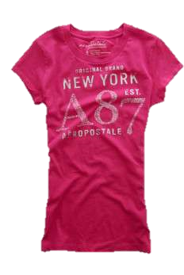
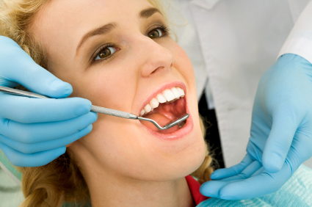
General Marketing #4
What are the three kinds of Products?
Goods, Services, Ideas
General Marketing
$200

Slide 11
Back

Slide 12
General Marketing #5
How do you calculate profit margin?
Sales Price – Production Cost
General Marketing
$300

Slide 13
Back

Slide 14
General Marketing #6
Name FIVE of the 12 marketing tactics
Emotional Appeal, Bandwagon, Stretch the Truth, Common Man, Testimonial, Transfer, Card Stacking, Beautiful People, Glittering Generalities, Name Calling, Repetition, Statistics
General Marketing
$500

Slide 15
Back

Slide 16
General Marketing #7
Manufacturer
Store
Customer
Distributer
In Place, what are the four steps in the Distribution Channel?
General Marketing
$400

Slide 17
Back

Slide 18
General Marketing #8
What is a patent?
The exclusive right granted by a government to an inventor to manufacture, use, or sell an invention for a certain number of years.
General Marketing
$300

Slide 19
Back

Slide 20
General Marketing #9
Which of the 12 marketing strategies is being used in this commercial?
Common Man
General Marketing
$400

Slide 21
Back

Slide 22
Logos
1
2
3
4
5
6
7
8
9

Slide 23
Logos #1
What company’s logo is this?
PBS
Logos
$200

Slide 24
Back

Slide 25
Logos #2
What gas company’s logo features a red star?
Texaco
Logos
$300

Slide 26
Back

Slide 27
Logos #3
Earn up to $500 if you can name the car company each logo is from.
Logos
$1-500

Slide 28
Back

Slide 29
Logos #4
Can you identify the logo?
Paramount Pictures
Logos
$300

Slide 30
Back

Slide 31
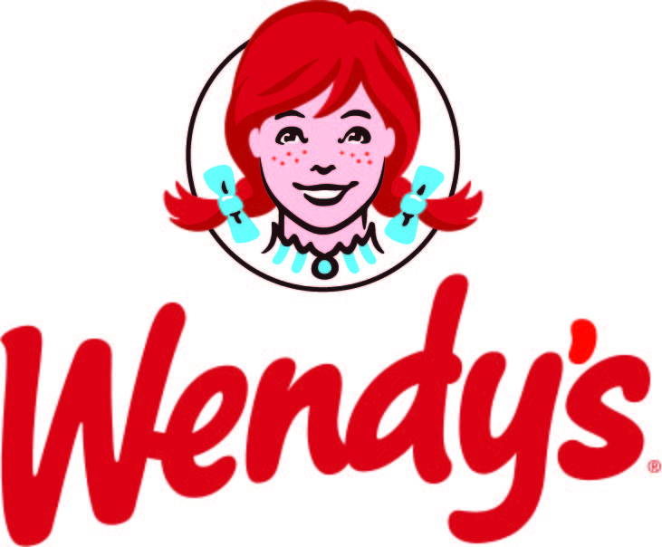
Logos #5
Name the logo for $100 points a piece.
Logos
$1-500

Slide 32
Back

Slide 33
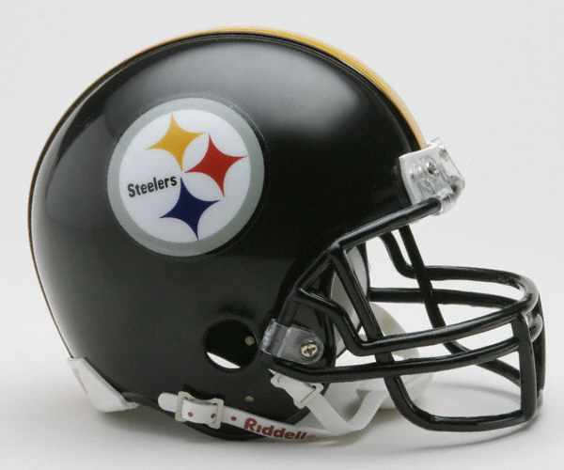
Logos #6
What NFL team is the only team to have their logo displayed on only one side of the helmet?
Pittsburg Steelers
Cleveland Browns
New York Giants
Denver Broncos
San Francisco 49ers
Logos
$300

Slide 34
Back

Slide 35
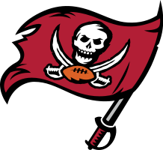
Logos #7
Name the team associated with each sports logo—you get $100 for each correct answer. (You have to name the city and team name to get it right.)
Tennessee
Titans
Phoenix Suns
Memphis Grizzlies
Cincinnati Bengals
Tampa Bay Buccaneers
Logos
$1-500

Slide 36
Back

Slide 37
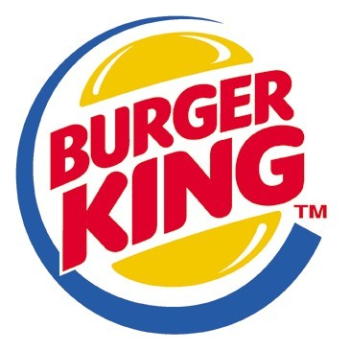
Logos #8
Name the logo for $100 points a piece.
Logos
$1-500

Slide 38
Back

Slide 39
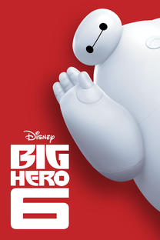
Logos #9
Name movie logo for $100 each!
Logos
$1-500

Slide 40
Miscellaneous
1
2
3
4
5
6
7
8
9

Slide 41
Back

Slide 42
Miscellaneous #1
What company has the most employees?
McDonalds
Microsoft
Wal-Mart
Disney
Misc.
$300

Slide 43
Back

Slide 44
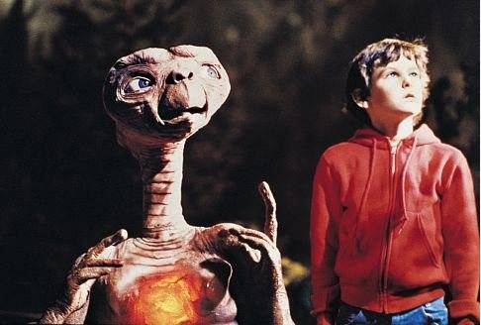
Miscellaneous #2
What candy’s sales skyrocketed after it was prominently used in a 1982 movie about an alien coming to live with a regular family?
*$200 Bonus—when candy was originally asked to be used, but turned it down?
Reese’s Pieces – E.T.
M&M’s
Misc.
$300

Slide 45
Back

Slide 46
Miscellaneous #3
What company did the little pig cry wee wee wee for?
Geico
Misc.
$400

Slide 47
Back

Slide 48
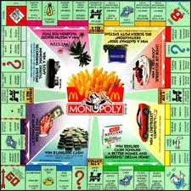
Miscellaneous #4
Which company uses the game Monopoly as an contest every few years?
McDonalds
Misc.
$300

Slide 49
Back

Slide 50
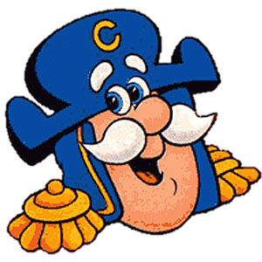
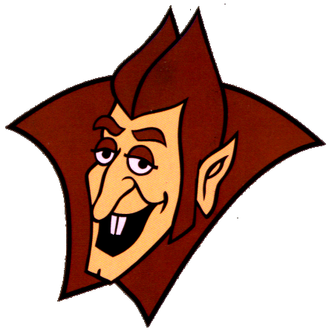
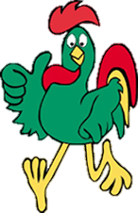
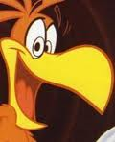
Miscellaneous #5
Name the cereal for each mascot for $100 each!
Capn’ Crunch
Fruit Loops
Count Chocula
Kellog’s Corn Flakes
Cocoa Puffs
Misc.
$1-500

Slide 51
Back

Slide 52
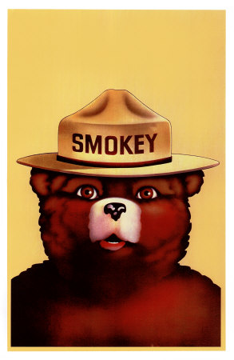
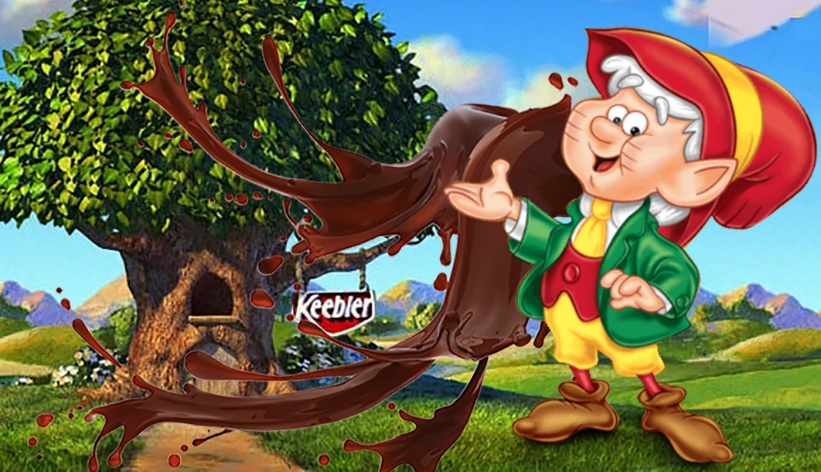
Miscellaneous #6
Earn up to $500 if you can name each of these famous advertising mascots!
Misc.
$1-500

Slide 53
Back

Slide 54
Miscellaneous #7
What product is sold by this woman on Youtube?
Purple Mattress
Misc.
$200

Slide 55
Back

Slide 56
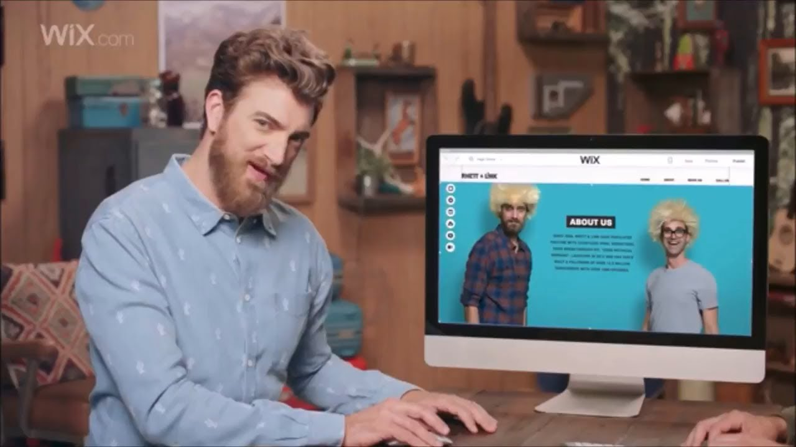
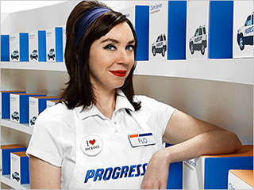
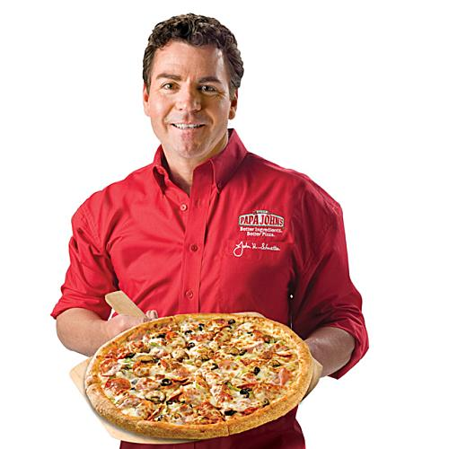
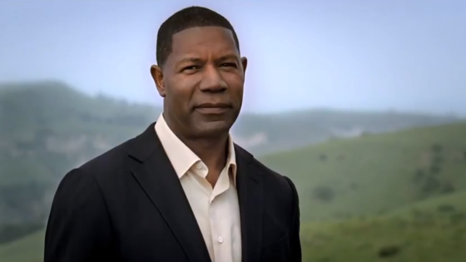
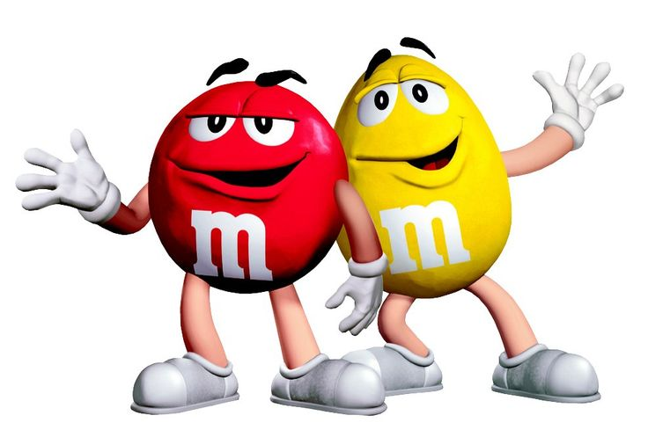
Miscellaneous #8
Can you identify the Spokesperson? Earn up to $100 for each correct answer!
Misc.
$1-500

Slide 57
Back

Slide 58
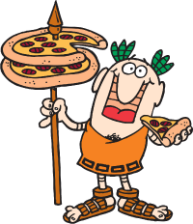
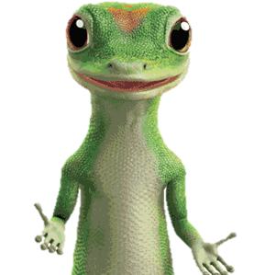
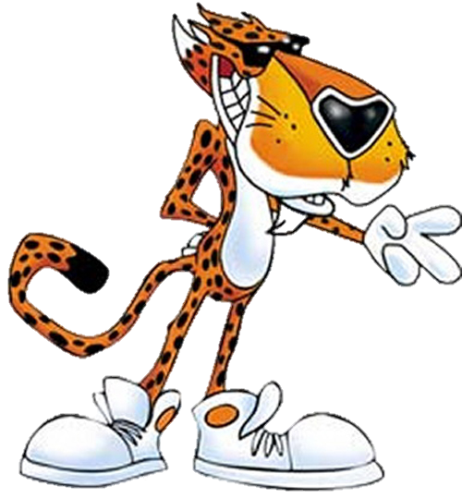
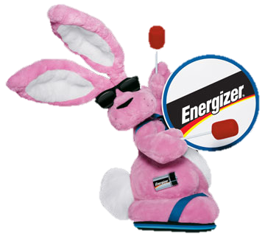
Miscellaneous #9
What company is this mascot from?
Misc.
$1-500

Slide 59
Jingles
1
2
3
5
6
7
4
8
9

Slide 60
Back

Slide 61
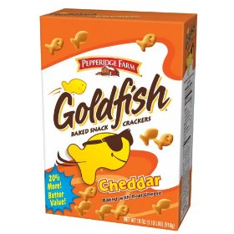
Jingles #1
“The snack that smiles back!”
Goldfish
Jingles
$200

Slide 62
Back

Slide 63
Jingles #2
“I am stuck on ________ cause _________ stuck on me!”
Band aid
Jingles
$300

Slide 64
Back

Slide 65
Jingles #3
What company is this from?
Jingle
Farmers
Jingles
$200

Slide 66
Back

Slide 67
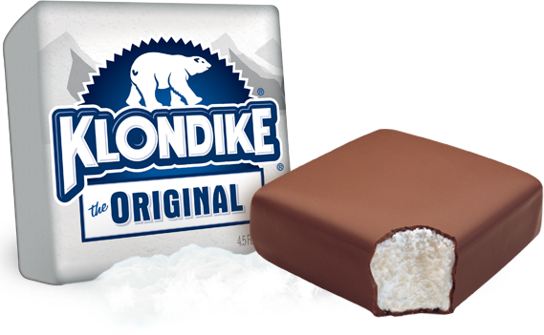
Jingles #4
What would you do-oo-oo for a ___________?
Jingles
$300

Slide 68
Back

Slide 69
Jingles #5
What company and product is this jingle selling?
Jingle
Stanley Steemer
Jingles
$300

Slide 70
Back

Slide 71
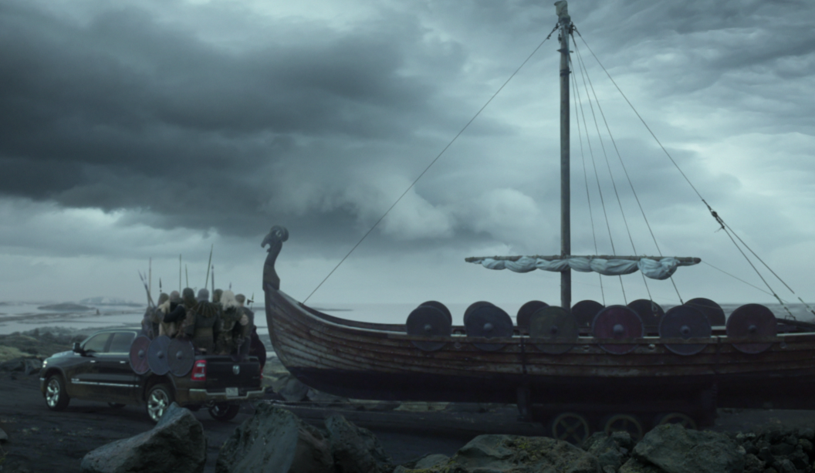
Jingles #6
Which band sings the song in this Ram commercial?
See Commercial
Queen
Jingles
$400

Slide 72
Back

Slide 73
Jingles #7
What does every kiss begin with? Sing the jingle. What is the company, and what do they sell?
“Every Kiss Begins with Kay”
Kay Jewelers
Jingles
$100

Slide 74
Back

Slide 75
Jingles #8
What product or company is this new jingle from?
Jingle
Jingles
$300

Slide 76
Jingles

Slide 77
Back

Slide 78
Jingles #9
What is the jingle for Nationwide Insurance? Sing it!
“Nationwide is on your side!”
Jingles
$100

Slide 79
Back

Slide 80
Slogans
1
2
3
4
5
6
7
9
8

Slide 81
Slogans #1
Match the tech company to it’s slogan!
Look Inside
Be What’s Next
Think Different
We Make IT Happen
Be Moved
Slogans
$1-500

Slide 82
Back

Slide 83
Slogans #2
Which of the following is the current slogan for Utah?
Utah: A Pretty, Great State
Utah: Wild and Wonderful
Utah: Find Yourself Here
Utah: Life Elevated
Slogans
$200

Slide 84
Back

Slide 85
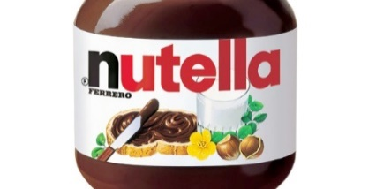
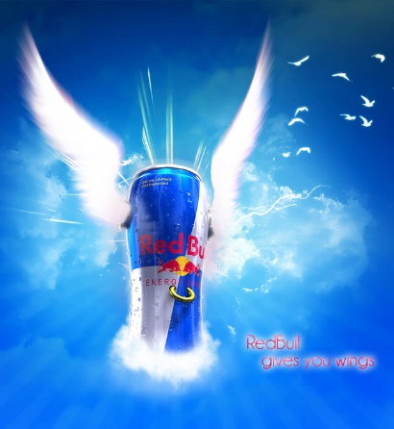
Slogans #3
Identify the slogans for $100 a piece!
You’re not you when you’re hungry
Dress for Less
Breakfast Never Tasted So Good.
Runs Deep
Gives You Wings
Slogans
$1-500

Slide 86
Back

Slide 87
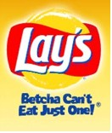
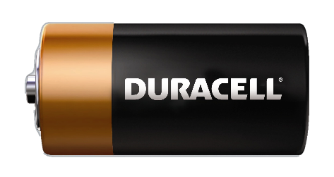
Slogans #4
Earn up to $500 by stating which companies these slogans are for.
Where a kid can be a kid.
Betcha can’t eat just one.
Save Money. Live Better
The ones you trust are always there. Trusted everywhere.
You’re in good hands
Slogans
$1-500

Slide 88
Back

Slide 89
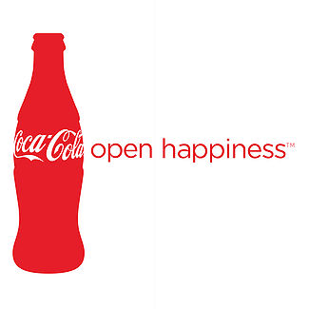
Slogans #5
“Open Happiness”
Slogans
$300

Slide 90
Back

Slide 91
Slogans #6
“Where the Good Stuff is.”
Arctic Circle
Slogans
$200

Slide 92
Back

Slide 93
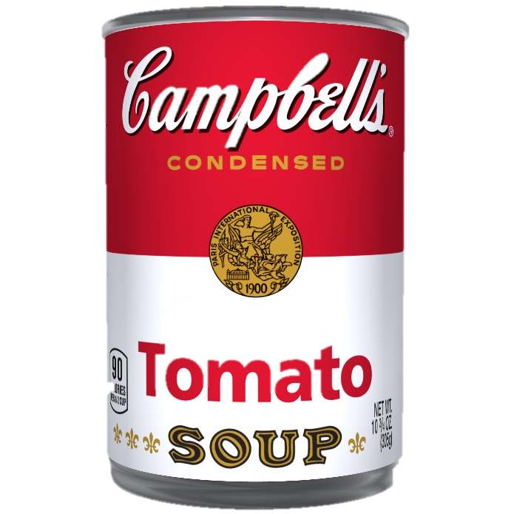
Slogans #7
“Mmm…mmm…Good!”
Slogans
$300

Slide 94
Back

Slide 95
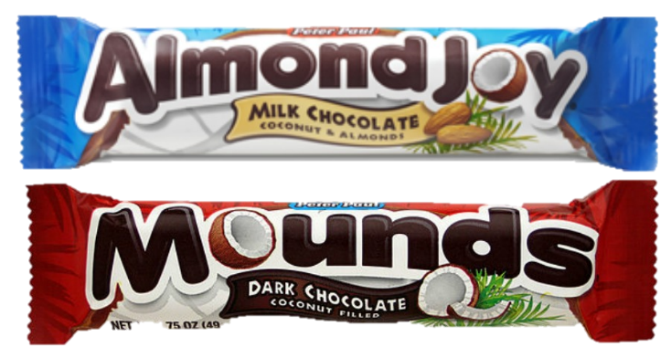
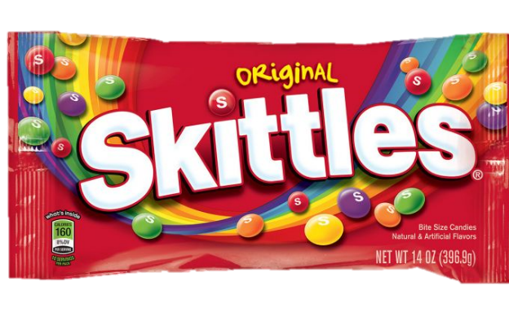
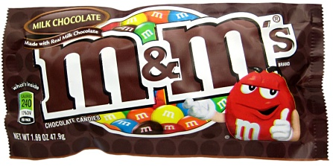
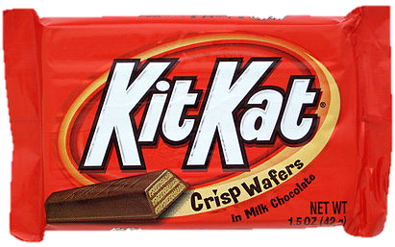
Slogans #8
Can you match the slogan to the candy?
Taste the Rainbow
Sometimes you feel like a nut, sometimes you don’t.
Melts in your mouth, not in your hands
Gimme a break
How many licks does it take?
Slogans
$1-500

Slide 96
Back

Slide 97
Slogans #9
What company’s slogan is:
“When it absolutely, positively has to be there overnight.”
Fedex
Slogans
$200

Slide 98
Back

