Slide 1
Computer Technology
Standard 1 - Basics
Standard 2 - Word
Standard 2 - Excel
Standard 2 - PowerPoint
Standard 2 - Access
Semester Test Review
Standard 3 - Internet
Standard 4 – Elec. Comm.

Slide 2
Excel/Spreadsheet
Review

Slide 3
Excel/Spreadsheets
Basics
Cell: Where a row and column intersect
Worksheet: One page in a workbook
Directions
Columns:
  Labeled: A, B, C, D
  Run Vertical
Rows:
  Labeled: 1, 2, 3, 4
  Run Horizontal

Slide 4
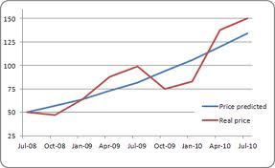
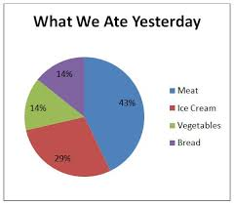
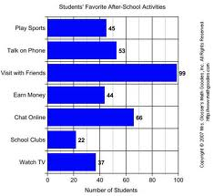
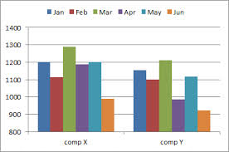
Excel Charts
Line Chart
Pie Chart
Column Chart
Bar Chart

Slide 5

Filtering/Sorting
Sorting: Sorts all information in ascending/descending order
  Ascending: A to Z; 1 to 10; Jan.-Dec.
  Descending: Z to A; 10 to 1; Dec.-Jan.
Filtering: Shows information that meets a certain criteria
  Example:
    Only showing students with an average score of 80%
    Only showing clients with the last name starting with “D”

Slide 6
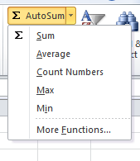
Formulas/Functions
Formula/Function always starts with =
AutoSum: includes the 5 most
common functions
AutoSum Functions
SUM: adds numbers
AVERAGE: average of a range
COUNT: counts #s/items used
MAX: finds biggest number in range
MIN: finds smallest number in range
Mathematical Symbols
Add: +
Subtract: -
Divide: /
Multiply: *

Slide 7
Formula/Functions
Formulas: equations that preform calculations on values in a worksheet
Functions: predefined formula that performs a calculation in a worksheet
Formula | Function
=B2*B3 | =SUM(A3:D6)
=A1+B1+C1 | =AVERAGE(C3:C7)
=B10/D5 | =COUNT(F3:F10)
=B2*(C5-C4) | =MAX(A5:A8)
=F4-D4 | =MIN(B6:B12)

Slide 8
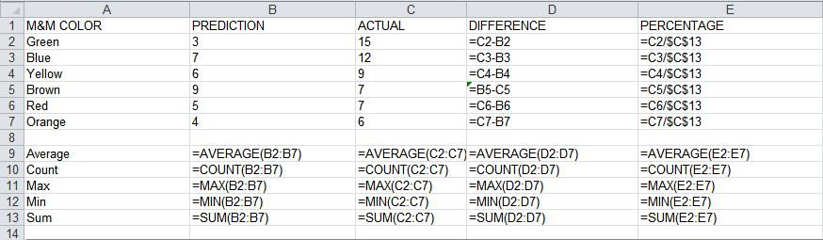
Relative/Absolute Addresses
Relative: cell reference changes as the formula is copied
Absolute: cell reference does not change as the formula is copied ($)
Absolute Addresses
Relative Addresses

Slide 9
Legend/Key
Key for interpreting the chart’s colors, patterns, etc.
Legend

Slide 10
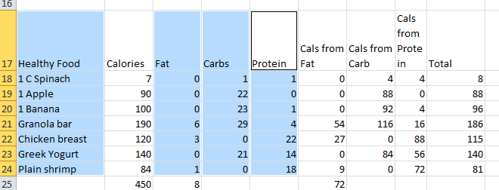
Selection
To select two different ranges in Excel, hold down the CTRL key

Slide 11
Database/Access
Review

Slide 12
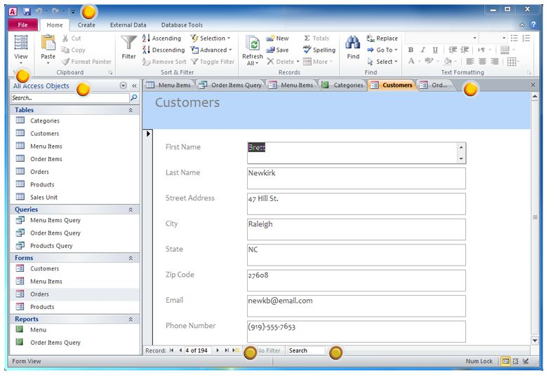
Access Window
Database: a collection of records

Slide 13
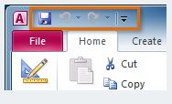
Quick Access Toolbar
Back to
Access Window
Lets you access common commands no matter with tab you’ve selected in the Ribbon

Slide 14
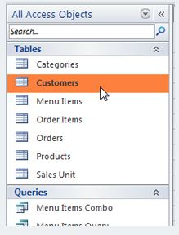
Navigation Pane
Back to
Access Window
Displays all of the objects contained in your database.
The objects are grouped by type.
  To open an object, double-click it.

Slide 15
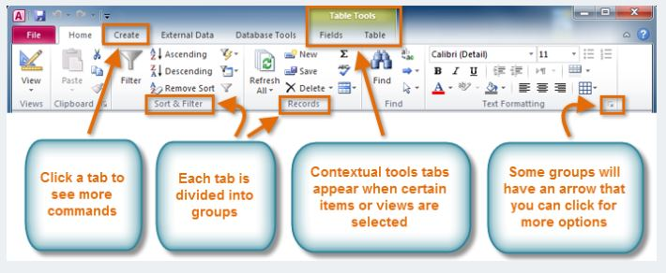
Ribbons
Back to
Access Window
Contains all of the commands you will need in order to do common tasks.
It contains multiple tabs, each made up of several groups of commands.

Slide 16
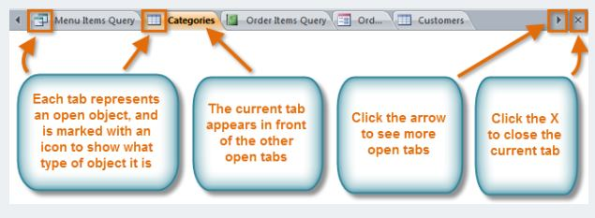
Document Tab Bar
Back to
Access Window
All open objects are displayed on the Document Tabs bar.
To view an object:
  Click on its tab
  Click the X on the right end of the bar to close the current tab.
  To see more tabs, click the arrow.

Slide 17

Record Navigation Bar
Back to
Access Window
Allows you to navigate through records one at a time.
Click the arrows to navigate through the records.
  You can jump to a specific record by typing its ID number into the white box.

Slide 18
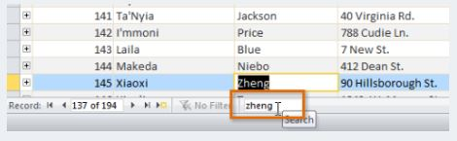
Record Search Box
Access Basic Terminology
Used to search for any term in the currently open object.
The first result that matches your search term will appear highlighted with a yellow border.
To navigate through additional results, press the Enter key.

Slide 19
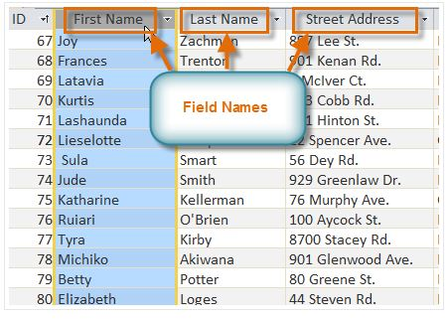
Basic Terminology
Field: category of information for which data is given in each individual record

Slide 20
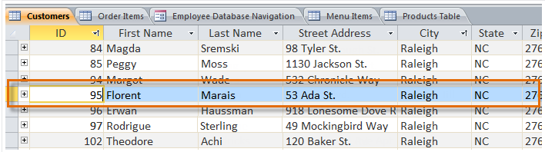
Basic Terminology
Record: all the information for one particular item in the database file

Slide 21
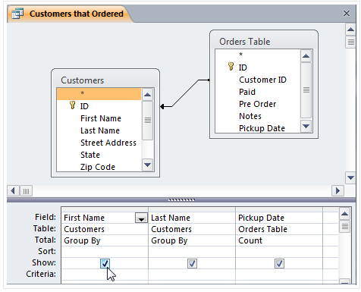
Basic Terminology
Query: a process(search) used to locate all records that satisfy a statement, rule, or criterion

Slide 22
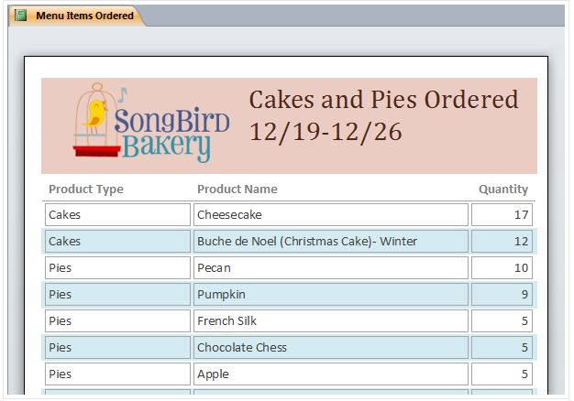
Basic Terminology
Table: a collection of associated records

Slide 23
Internet
Review

Slide 24
Internet
Global network of networks
  Internet is the largest WAN (wide area network)
WWW
  World Wide Web
HTML
  Programming language of the web

Slide 25
URL/Domains
URL (Uniform Resource Locator): address of a website, web page, or file on the web
  Example:
    http://www.cnn.com
Website Domains
.com | Commercial
.edu | Educational
.gov | Government
.int | International
.net | Network
.org | Non-profit organization

Slide 26
Hypertext Links
A word, phrase, or picture that links or connects you to another website
Useful so you don’t have to memorize a long web address
Hypertext links are usually blue with an underline

Slide 27
Web Browsers
An application program that allows you to view information on the web
Examples:
  Internet Explorer
  Google Chrome
  FireFox
  Safari

Slide 28
Home Page
1st page that opens every time a browser (FireFox, Internet Explorer, Safari) is open
  Example:
    When you click on Internet Explorer on your student computer it opens to the SJMS school website
    SJMS school website is the home page for the student computers

Slide 29
Web Conferencing
Video/audio conferencing between 2 or more people at different locations
  Examples
    Skype
    FaceTime

Slide 30
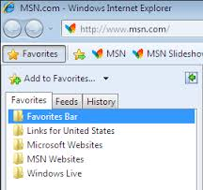
Favorites/Bookmarks
A place to store your favorite or often visited websites

Slide 31
Online Tools
Podcast
  Digital file downloaded to a computer or portable device and listened to at your convenience
Blog
  Short for webblog; an online journal or log
Wiki
  A collaborative website that allows users to add, modify, or delete content

Slide 32
Boolean Operators
To narrow down internet searches, use BOOLEAN OPERATORS
Boolean operators:
  AND/+ (peanut AND butter) (peanut + butter)
  OR (peanut OR butter)
  NOT/- (peanut NOT butter) (peanut – butter)
  * (used as a wild card)

Slide 33
Acceptable Use Policy (AUP)
Guidelines on how a network can and should be used.
  Every school year you sign a AUP before you can login to a school computer.

Slide 34


Copyright
The rights processed by the owner of information or resources
Trademark
Protecting a name, symbol, or logo so that others can’t use it

Slide 35




No copyright, free to all
Public Domain
Copyrighted but free
Freeware
Copyrighted with use restrictions
Shareware
Copyrighted, at a cost, all restrictions possible
All Rights Reserved
Copyrighted, restrictions stipulated by creator. Free to share.
Creative Commons

Slide 36
Plagiarism
Copying someone else’s work and claiming it as your own or not giving proper credit to the owner
How to Protect Yourself?
Use footnotes/endnotes
Use Bibliography/Works Cited

Slide 37
Electronic Communication
Review

Slide 38
Email Basic Terminology
Attachment
  Electronic file/photo sent with an email message
CC
  Courtesy copy
    Example: Sending email to parent might send the vice principals a courtesy copy so they know what is going on
BCC
  Blind copy
  The person you are sending the email to does not know you sent it to the person in the BCC

Slide 39
Reply vs. Reply All
Reply
  Sends only to the person who sent the email
Reply All
  Sends to everyone who was sent the email

Slide 40
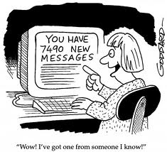
Spam
Unwanted emails
  Emails can be sold to different companies and those companies then send you emails you never asked for

Slide 41
Netiquette
Proper etiquette to use with electronic communication
  Some proper email etiquette:
    DON’T TYPE IN ALL CAPS
    Use a Subject Line
    KISS (Keep it short & simple)

Slide 42
PowerPoint
Review

Slide 43
Layouts
Placement of text and objects on the slide
Layout Options:
  Title Slide
  Title and Content
  Section Header
  Two Content
  Comparison
  Title Only
  Blank
  Content with Caption
  Picture with Caption

Slide 44
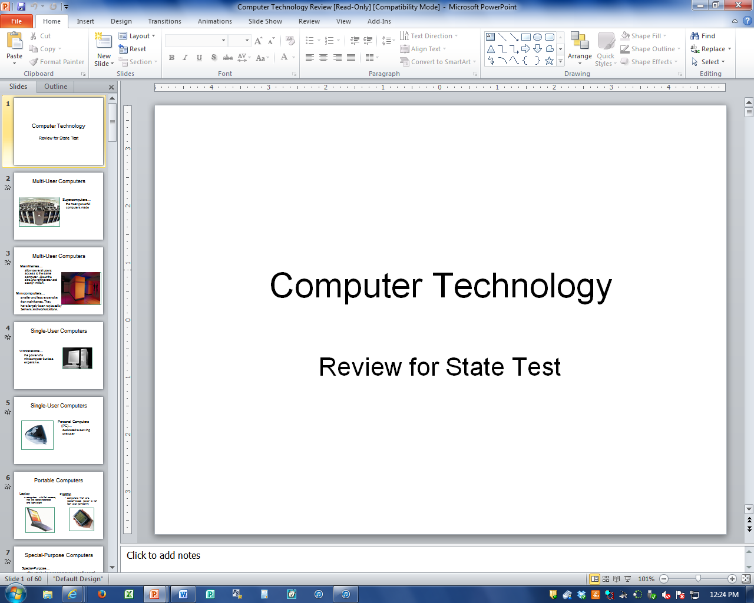
Normal View
What it looks like when you are creating the PowerPoint

Slide 45
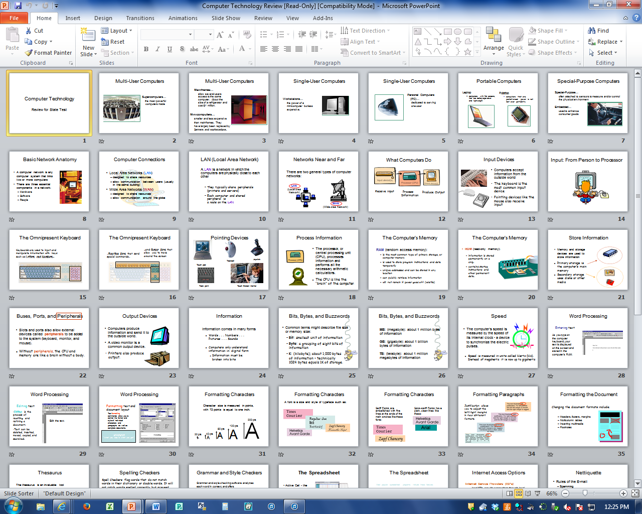
Slide Sorter
Small, visual representation of the slides

Slide 46
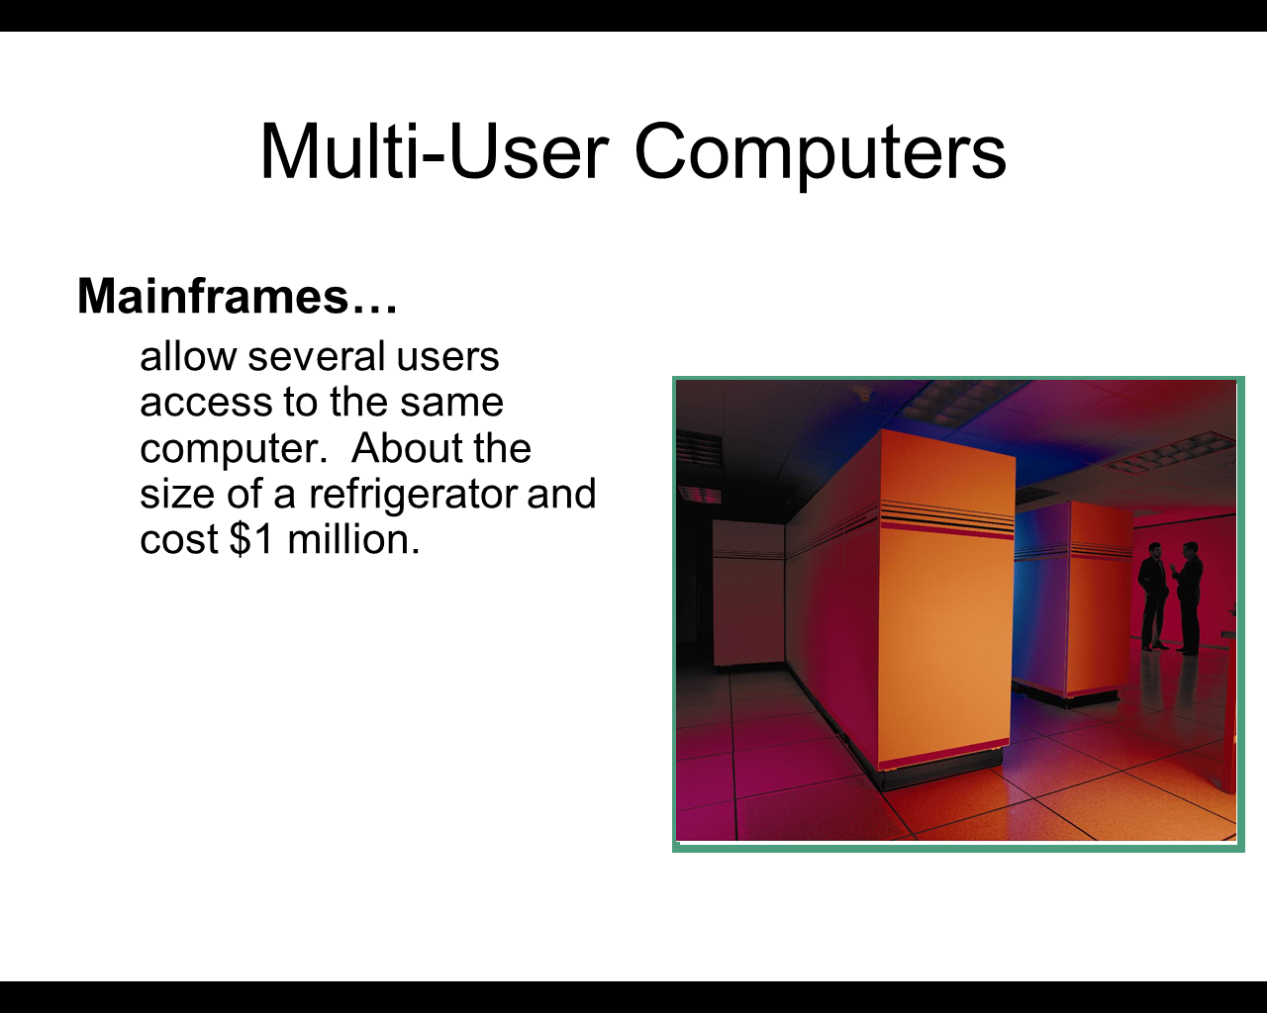
Slide Show View
How it is presented to a group; one slide at a time

Slide 47
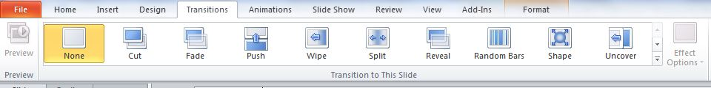
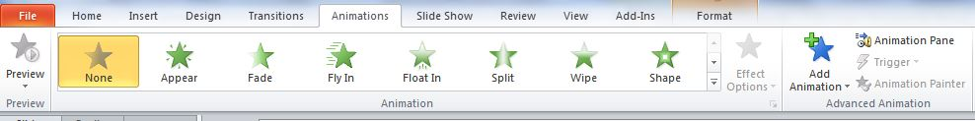
Transitions
How the ENTIRE slide will enter the screen
Animations
Adding movement or an effect to text or objects within a slide

Slide 48
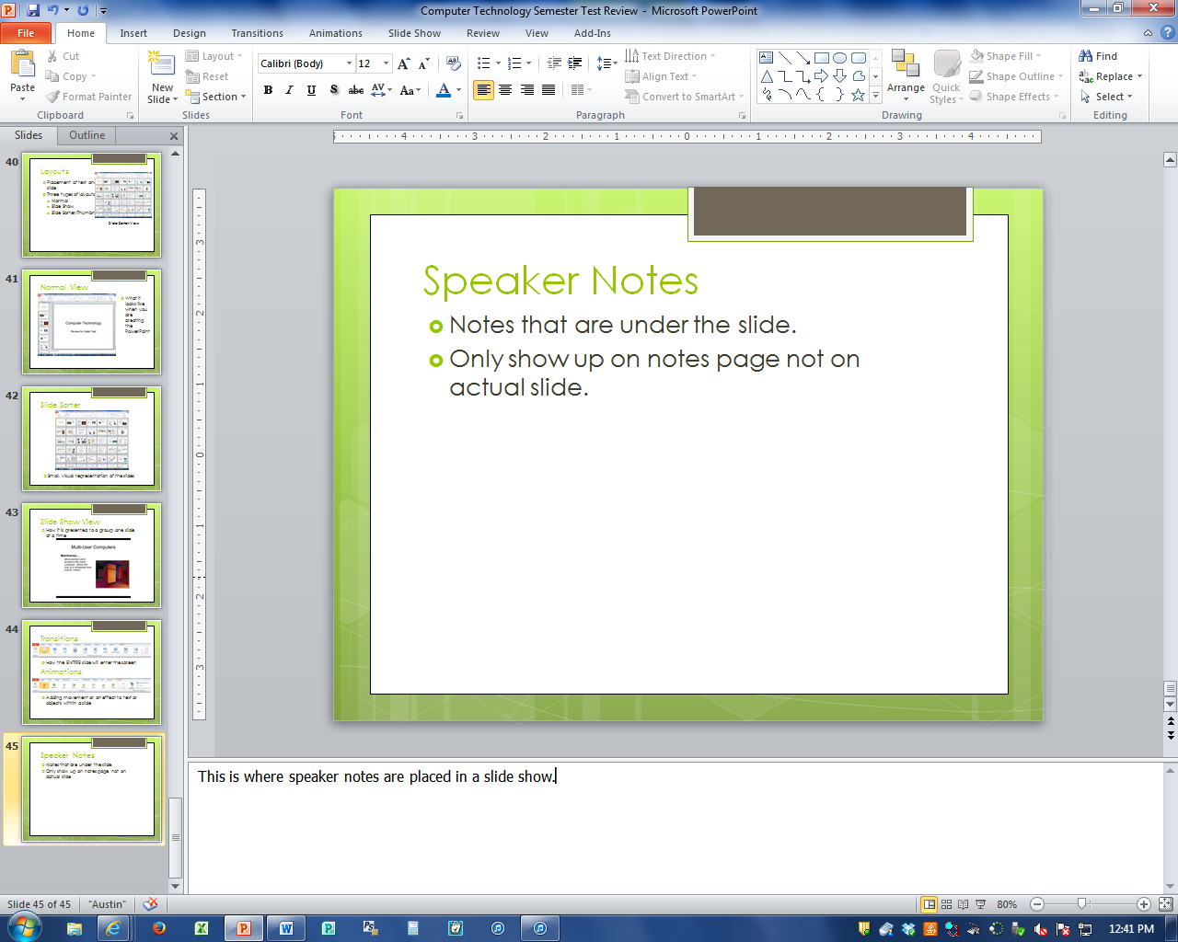
Speaker Notes
Notes that are under the slide.
Only show up on notes page not on actual slide.
This is the area where a speaker can make notes to refer back to during a presentation
Notes:
This is where speaker notes are placed in a slide show.

Slide 49
Printing PowerPoints
Printing Options:
  Outline
  Handouts (print several slides on one page)
  Slides
  Slide Thumbnails with notes

Slide 50
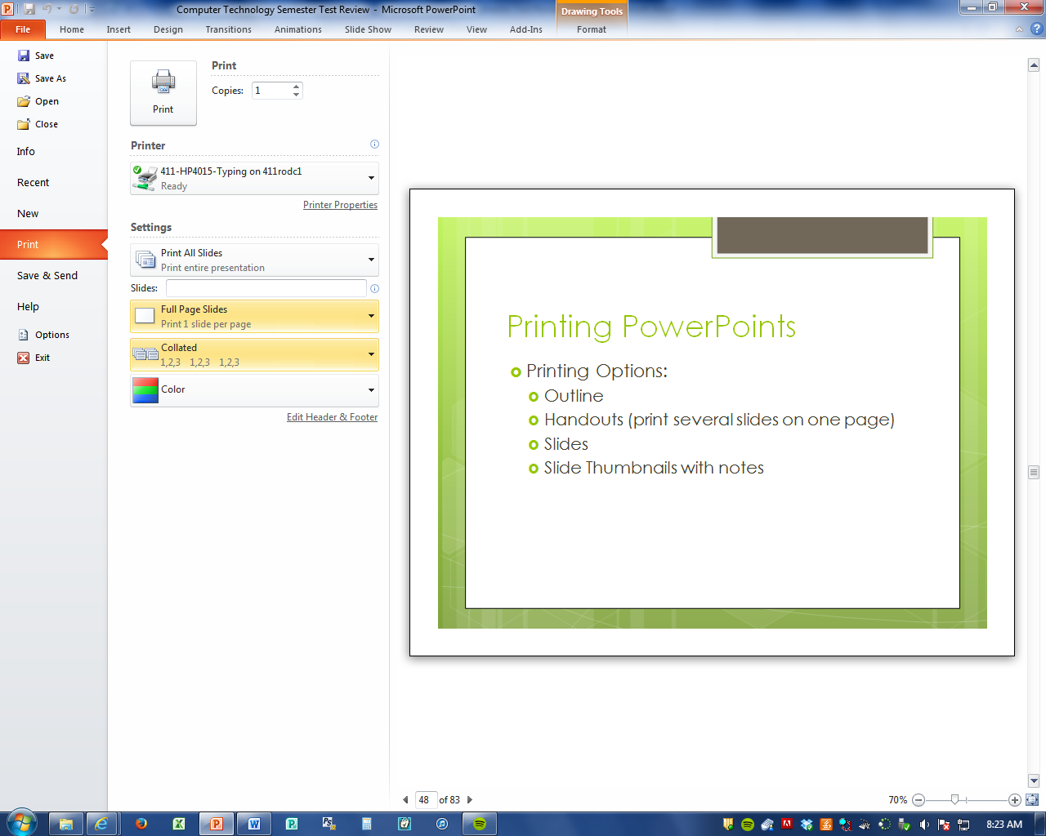
Full Slide Printing

Slide 51
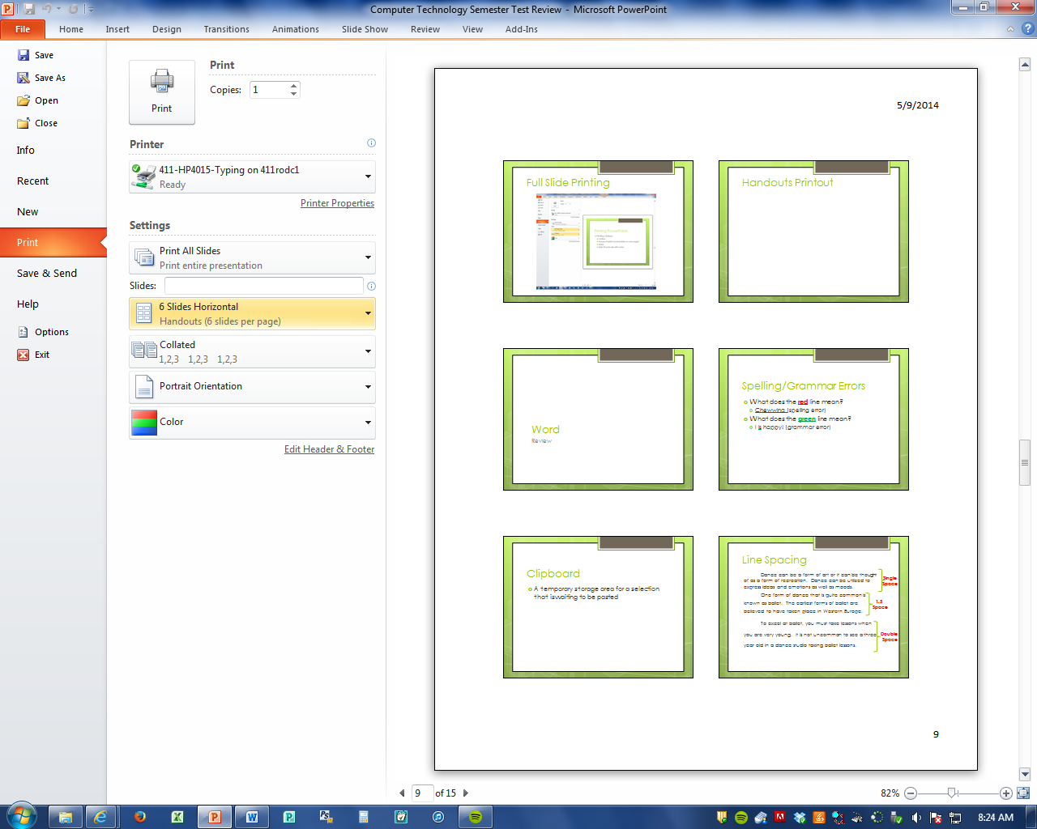
Handouts Printout

Slide 52
Word
Review

Slide 53
Spelling/Grammar Errors
What does the red line mean?
  Chewwing (spelling error)
What does the green line mean?
  I is happy! (grammar error)

Slide 54
Clipboard
A temporary storage area for a selection that is waiting to be pasted

Slide 55
Line Spacing
Dance can be a form of art or it can be thought of as a form of recreation. Dance can be utilized to express ideas and emotions as well as moods.
One form of dance that is quite common is known as ballet. The earliest forms of ballet are believed to have taken place in Western Europe.
To excel at ballet, you must take lessons when you are very young. It is not uncommon to see a three year old in a dance studio taking ballet lessons.
Single Space
1.5
Space
Double
Space

Slide 56
Alignment
Dance can be a form of art or it can be thought of as a form of recreation. Dance can be utilized to express ideas and emotions as well as moods.
One form of dance that is quite common is known as ballet. The earliest forms of ballet are believed to have taken place in Western Europe.
To excel at ballet, you must take lessons when you are very young. It is not uncommon to see a three year old in a dance studio taking ballet lessons.
In addition to starting at a very young age, hours and hours of practice are also required to develop into a skilled performer of ballet.
Left
Align
Right Align
Center Align
Justify Align

Slide 57
Formatting
This text has no formatting to it.
This text has bold formatting.
This text has italic formatting.
This text has underline formatting.

Slide 58
Word Wrap
Word wrap is when the computer automatically sends the text to the next line WITOUT hitting Enter.
  Also known as soft return.
Pressing the ENTER key is a HARD RETURN

Slide 59
Header/Footer
Text which appears on every page of the document. Can be at the top or the bottom. Can include:
  Page numbers
  Date
  File name
  File location

Slide 60
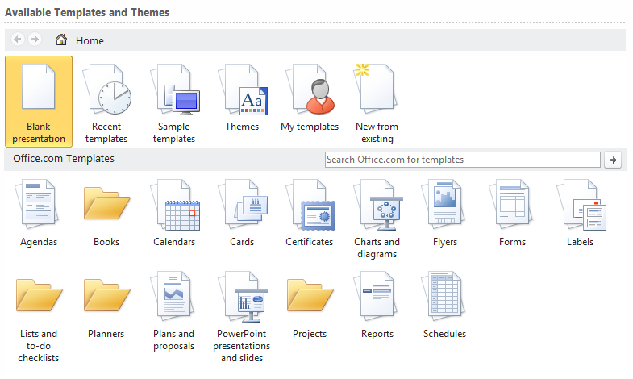
Template
A document that provides structure for commonly used Business documents.
  Calendars
  Cards
  Agendas
  Forms
  Certificates
  Fax Covers
  Etc.

Slide 61
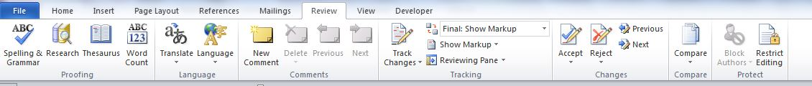
Thesaurus
Looking up a word to find another word that means the same or the opposite.

Slide 62
Indents
First Line Indent Example
Dance can be a form of art or it can be thought of as a form of recreation. Dance can be utilized to express ideas and emotions as well as moods.
Hanging Indent Example
One form of dance that is quite common is known as ballet. The earliest forms of ballet are believed to have taken place in Western Europe.

Slide 63
Lists
Numbered List | Bulleted List | Multi Level List
Apples Oranges Bananas Pineapple | Apples Oranges Bananas Pineapple | Fruits a. Apples i. Green ii. Red b. Banana Veggies a. Carrots b. Peas

Slide 64
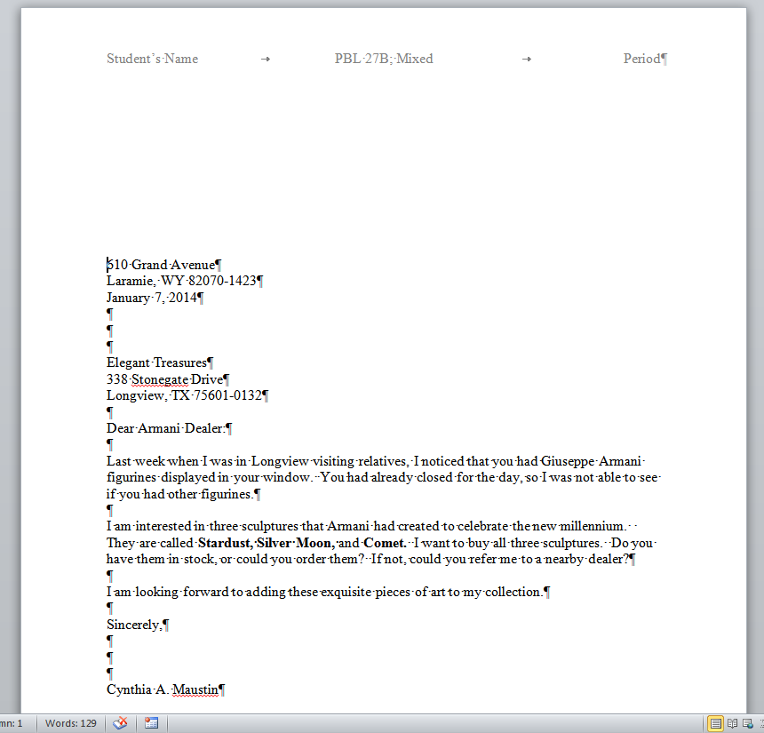
Non-Printing Characters
Home
Paragraph
¶
→ = Tab
¶ = Paragraph
· = Space

Slide 65
Letters
Review

Slide 66
Letter Format
Block Format
  Everything is aligned to the left
  No indents

Slide 67
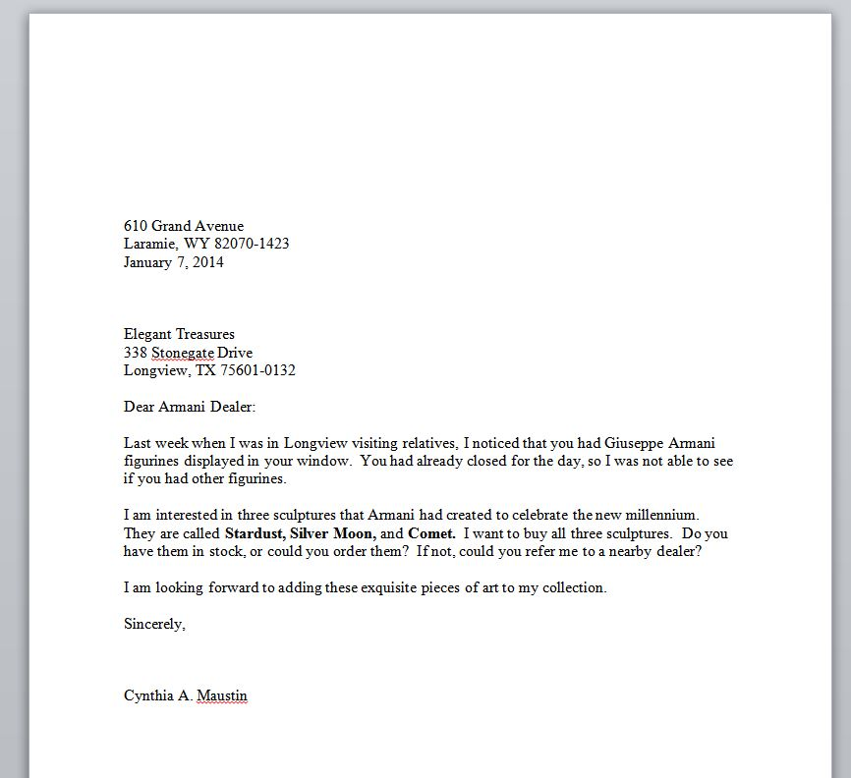
Block Letter Example
Everything is lined up to the left side. NO INDENTS!

Slide 68
Parts of a Letter
amj
Enclosure

Slide 69
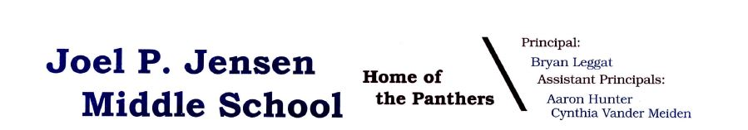
Return Address
Return to Parts of a Letter
Address of the person who is SENDING the letter.
If the letter has LETTERHEAD there will be NO RETURN ADDRESS
Letterhead Examples

Slide 70
Date
Return to Parts of a Letter
This is the date the letter was created or sent out
Should be spelled out
  Example: January 1, 2014
    DO NOT DO 1/1/14; Jan. 1, 2014
CORRECT
INCORRECT

Slide 71
Letter Address
Return to Parts of a Letter
Address of the person who is receiving the letter

Slide 72
Salutation
Return to Parts of a Letter
Salutation always starts with the word “Dear”
Greeting of the letter
If you don’t know the person use a proper title:
  Mrs./Ms./Miss
  Mr.
  Dr.
Examples:
  Dear Mrs. Higgs
  Dear Eric

Slide 73
Body
Return to Parts of a Letter
Body is usually SS with a DS between paragraphs.
Usually in block format (no indents) but may have indented paragraphs depending on style

Slide 74
Complimentary Close
Return to Parts of a Letter
Closing of the letter
If complimentary close is more than one word, the second word is ALWAYS lowercase
Common Examples:
  Sincerely
  Sincerely yours
  Yours Truly
  Cordially
  Cordially yours

Slide 75
Writer’s Block
Return to Parts of a Letter
This can include the following:
  Writer’s Name
  Title
  Department

Slide 76
Typist Initials
Return to Parts of a Letter
Initials of the person who typed the letter
This person is DIFFERENT than the writer
ALWAYS LOWERCASE
DS after writer’s block and left align typist initials
AKA reference initials

Slide 77
Attachment/Enclosure
Attachment
Physically attached to the letter using a paper clip, staple, rubber band, etc.
  Copy of a bill
  Agenda to a meeting
Enclosure
Something that is included in the letter but is not physically attached to the letter
  Certificate
  Check
  Picture

Slide 78
Mixed Punctuation
  Colon (:) after salutation
  Comma (,) after complimentary close
Example:
Dear Ann:
Sincerely yours,

Slide 79
Basics
Review

Slide 80
CPU
Central Processing Unit
“Brain” of the computer
Where all the processing of a computer takes place

Slide 81
LAN vs. WAN
LAN (Local Area Network)
Computers and devices connected within a confined space
  Examples: SJMS, Office Building
WAN (Wide Area Network)
Multiple computers connected over a large geographical area
  Examples: Internet, Jordan School District

Slide 82
RAM vs. ROM
RAM (Random Access Memory)
Temporary storage used when the computer is on.
Information is lost when the computer is turned off
ROM (Read Only Memory)
Used in the boot process that stores permanent instructions for the computer

Slide 83
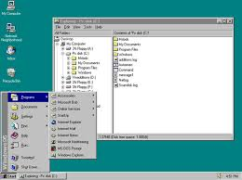
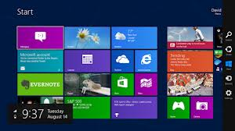
Operating System
Software that produces communication between the user, the application software and the hardware
  Examples
    Windows 7
    Windows Vista
    Windows XP
    Windows 98
    Windows 95

Slide 84

Network
Two or more computers/devices connected together to communicate or share information

Slide 85
Input Devices
Units that gather information and transform that information into a series of electronic signals for the computer.
Output Devices
Devices that display, print, or transmit the results of processing from the computer’s memory.

Slide 86
Input/Output Devices
Input Devices
Output Devices
Keyboard
Mouse
Scanner
Microphone
Monitor
Printer
Speakers
Projector

Slide 87
Peripheral Devices
Devices used to expand the computers input, output, and/or storage capabilities.
Examples of
Peripheral Devices
Webcam
External Hard Drive
Microphone
Scanner
Modem
Digital Camera

Slide 88
Storage Devices
A device used to store data when the computer is turned off
  Examples
    CD/DVD
    Hard Disk
    Flash Drive
    External Hard Drive
    Cloud

Slide 89
Save vs. Save As
Save
Save As
Save in the same location
Save with the same document name
Can choose what location to save as
Can choose what to save the document name as

Slide 90
Memory Size
Name | Size
Bit | 0 or 1
Byte | 8 bits
Kilobyte | 1,000 bytes
Megabyte | 1 million bytes
Gigabyte | 1 billion bytes
Terabyte | 1 trillion bytes

Slide 91
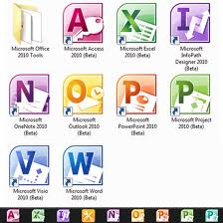
Application Software
Software designed to help you carry out a specific task
Examples:
  PowerPoint
  Word
  Excel
  Publisher

Slide 92
Troubleshooting
CTRL + ALT + DELETE
Restart
Too many large tasks running at a time slows down a computer
Multi-tasking – Making sure that the instructions and data from one area of memory don’t interfere with memory allocated for other programs.

Slide 93
Types of Computers
Review

Slide 94
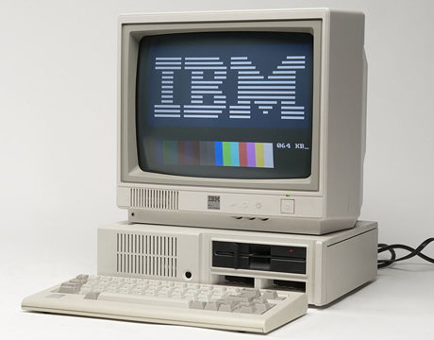
Microcomputer
A personal computer; designed to meet the needs of an individual.
Provides access to a wide variety of computing applications, such as word process, photo editing, e-mail, and internet.
IBM Personal Computer
(1983)
Tidbit: In common usage, "microcomputer" has been largely replaced by the term personal computer or PC, which meant to be used by one person at a time. IBM first promoted the term "personal computer" to differentiate themselves from other microcomputers.

Slide 95
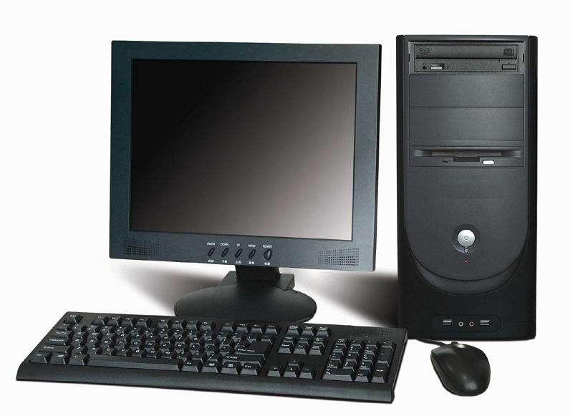
Desktop Microcomputer
CPU is located inside the system unit.
A microcomputer that fits on a desk and runs on power from an electrical wall outlet.
The CPU can be housed in either a vertical or a horizontal system unit.
Separate components (keyboard, mouse, etc.) are each plugged into the computer.

Slide 96
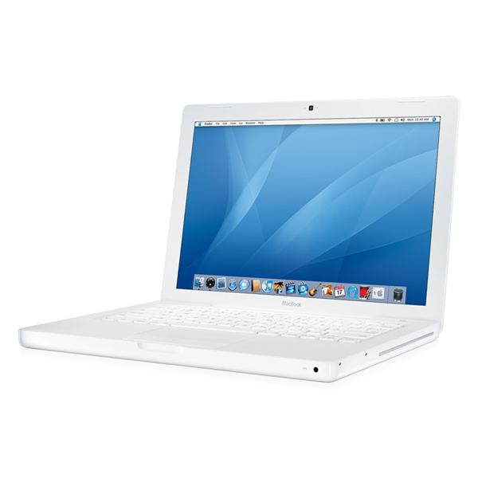

Laptop {Notebook} Computer
A portable, compact computer that can run on an electrical wall outlet or a batter unit.
All components (keyboard, mouse, etc.) are in one compact unit.
Usually more expensive than a comparable desktop.
Sometimes called a “Notebook”.
Mac (Apple) Laptop
PC (Windows) Laptop

Slide 97
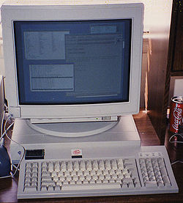
Workstation
Powerful desktop computer designed for specialized tasks.
Can tackle tasks that require a lot of processing speed.
Can also be an ordinary personal computer attached to a LAN (local area network)
Sun SPARCstation
(early 1990s)

Slide 98
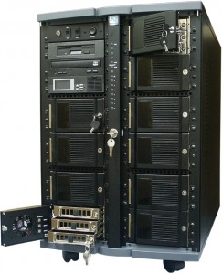
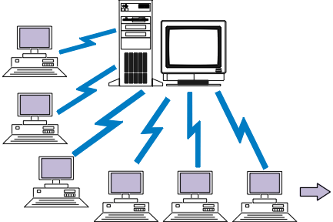
Server
Purpose is to “serve”
A computer that has the purpose of supplying its users with data; usually through the use of a LAN (local area network)

Slide 99
Viruses
Review

Slide 100
Computer Virus
Set of program instructions that attaches itself to a file, reproduces itself, and/or spreads to other files

Slide 101

Computer Virus
Computer viruses can
  Corrupt files
  Destroy data
  Display irritating messages
  Corrupt computer systems

Slide 102
Spreading Viruses
Viruses spread because people distribute infected files by exchanging disks and CDs, sending e-mail attachments, and downloading documents from the Internet.
Viruses attach themselves to files with .exe, .com, or .vbs filename extensions
When you open the infected file, the virus opens and waits to infect the next program you run or disk you use.

Slide 103

Protecting Yourself
Antivirus Software
Set of utility programs that looks for and eradicates a wide spectrum of problems, including viruses, Trojan horses, and worms
Examples of Antivirus Software

