Slide 1
CDA 15
1, 2, 4 or More!

Slide 2
Monty and the World of Possibilities

Slide 4
1, 2, 4, or More!
Bachelors
Associates
1
4
Masters
2
More!
Certification
PhD

Slide 5
Careers that need Certifications
Phlebotomist
Pharmacy Technician
Surgical Technologist
Medical Assistant
Certified Nurse’s Assistant
Dental Assistant
Court Reporter
Occupational Therapy Aide
Physical Therapy Aide
Bookkeeper
Restaurant Manager
Travel Agent
Web Designer
Auto Mechanic
Cosmetologist
Emergency Medical Technician (EMT)
Real Estate Agent
Message Therapist

Slide 6
Careers that need Associates
Radiation Therapist
Diagnostic Medical Sonographer
Dental Hygienist
Web Developer
Air Traffic Controller
Nuclear Technician
Computer Programmer
Registered Nurse
HVAC Installer
Electronic Engineering Technician
Veterinary Technician
Police Officer
Avionics Technician
Respiratory Therapist
Funeral Service Worker
Drafter
Computer Network Specialist
Paralegal

Slide 7
What is your Degree/Income Ratio?
Mechanic – 1 year/$40,000
Dental Hygienist - 2 Year/$67,000
Computer Info Systems Manager – 4 Year/$107,000
Physical Therapist – 6 Year/$76,000
Anesthesiologist – 14 year/$300,000
Masters in Culinary Arts – 6 Year/$31,000
Masters in Education – 6 Year/$55,000
Masters in Social Work – 6 Year/$37,000
Masters in Music – 6 Year/$51,000
Is the degree worth the pay?
Is the pay worth the love of the job?
Is the student loan debt worth the degree?
What is the OCCUPATION I want, and what degree do I need to get there?

Slide 8
Step Up – Teen Takeover

Slide 9
How do I PAY for college?
Get a job -
Yes, you CAN work through college! If you get a certification in your field, this can be a great way to have a well-paying job while going to school.
FAFSA – Student aide and pel grants
All US Citizens and permanent residents qualify to apply for FAFSA
Pel Grants do not have to be paid back!
Scholarships
Academic
Average Academic Performance Scholarships
Focus on community service, leadership, strength of a written essay, etc.
Athletic
There are scholarships for practically every sport. Can be VERY competitive
Minorities
Do not have to be “full” minority to apply
Women
Generally for areas where women are less common
Creative Scholarships
Music, Art, Dance, etc. Also very competitive
Unusual Scholarships
Usually sponsored by private companies
Community Service
Specialty
CTE Scholarships or other areas
Student Loans
Be careful in using student loans—ONLY use them for school, not to live on
You cannot get rid of loans—even if you declare bankruptcy, you still have to pay student loans!

Slide 10
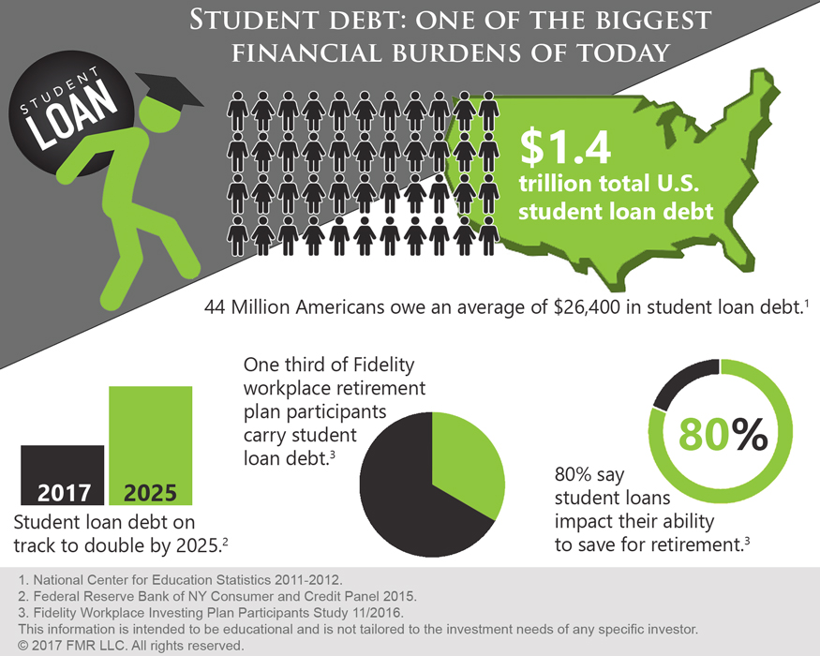

Slide 11
Out of State Tuition
University of Utah
In State | Out of State
$6,594 | $20,986
University of California
In State | Out of State
$12,862 | $22,878

