Slide 1
CDA 12

Slide 2
First…
a challenge…

Slide 3
Solve the equation:
What is 46% of 15477?

Slide 4
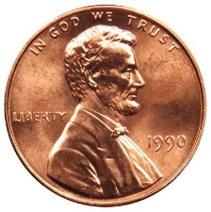
In this picture you can see 6 coins in the shape of a cross. Moving just ONE, can you form 2 lines, each with 4 coins?

Slide 5
Johnny’s mother had three children. The first child was named April. The second child was named May. What was the third child’s name?

Slide 6
Do you know how to cha-cha?

Slide 7
Grit

Slide 8
Do you have grit?
Take the Survey!

Slide 9
Grit

Slide 10
Fixed Mindset
Intelligence – ability to learn quickly and easily is FIXED.
Look smart at ALL costs
Effort is bad. If you have to work hard you are not smart.
If you don’t get it at first you either WILT or RUN.
If something is hard you may decide to spend less time on it in the future and maybe even consider cheating.

Slide 11
Growth Mindset
Intelligence can be developed over time
Learn at all costs
Effort is good.
Working hard makes you smarter
Focus is on learning.
If you don’t do well on something you want to work harder from now on.

