Slide 1
What Does My Future Look Like?
By Jennifer Goulding

Slide 2
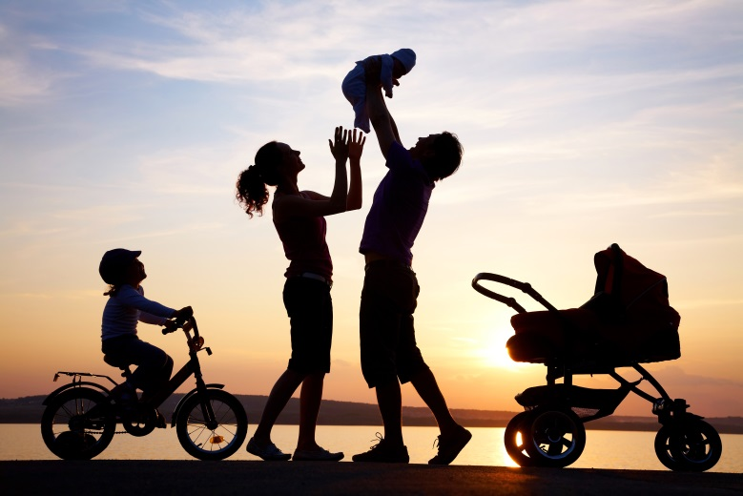
My Future Family
I want to marry someone who is kind to me and treats me well.
He needs to have a college education.
He needs to love kids!
I want to have four kids: 2 boys and 2 girls!

Slide 3
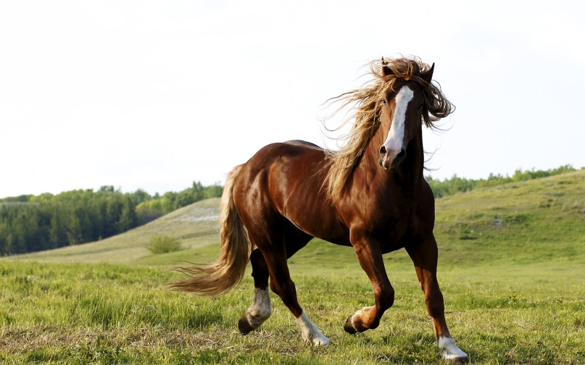
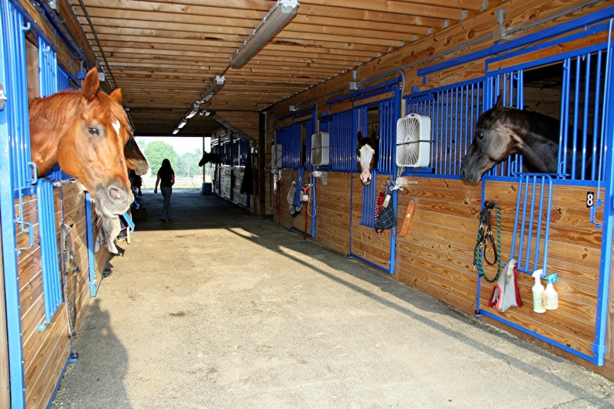
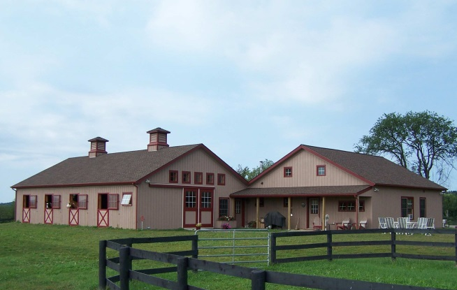
Where I Will Live
My dream is to live in the country in a little country house and have horses and lots of property.

Slide 4
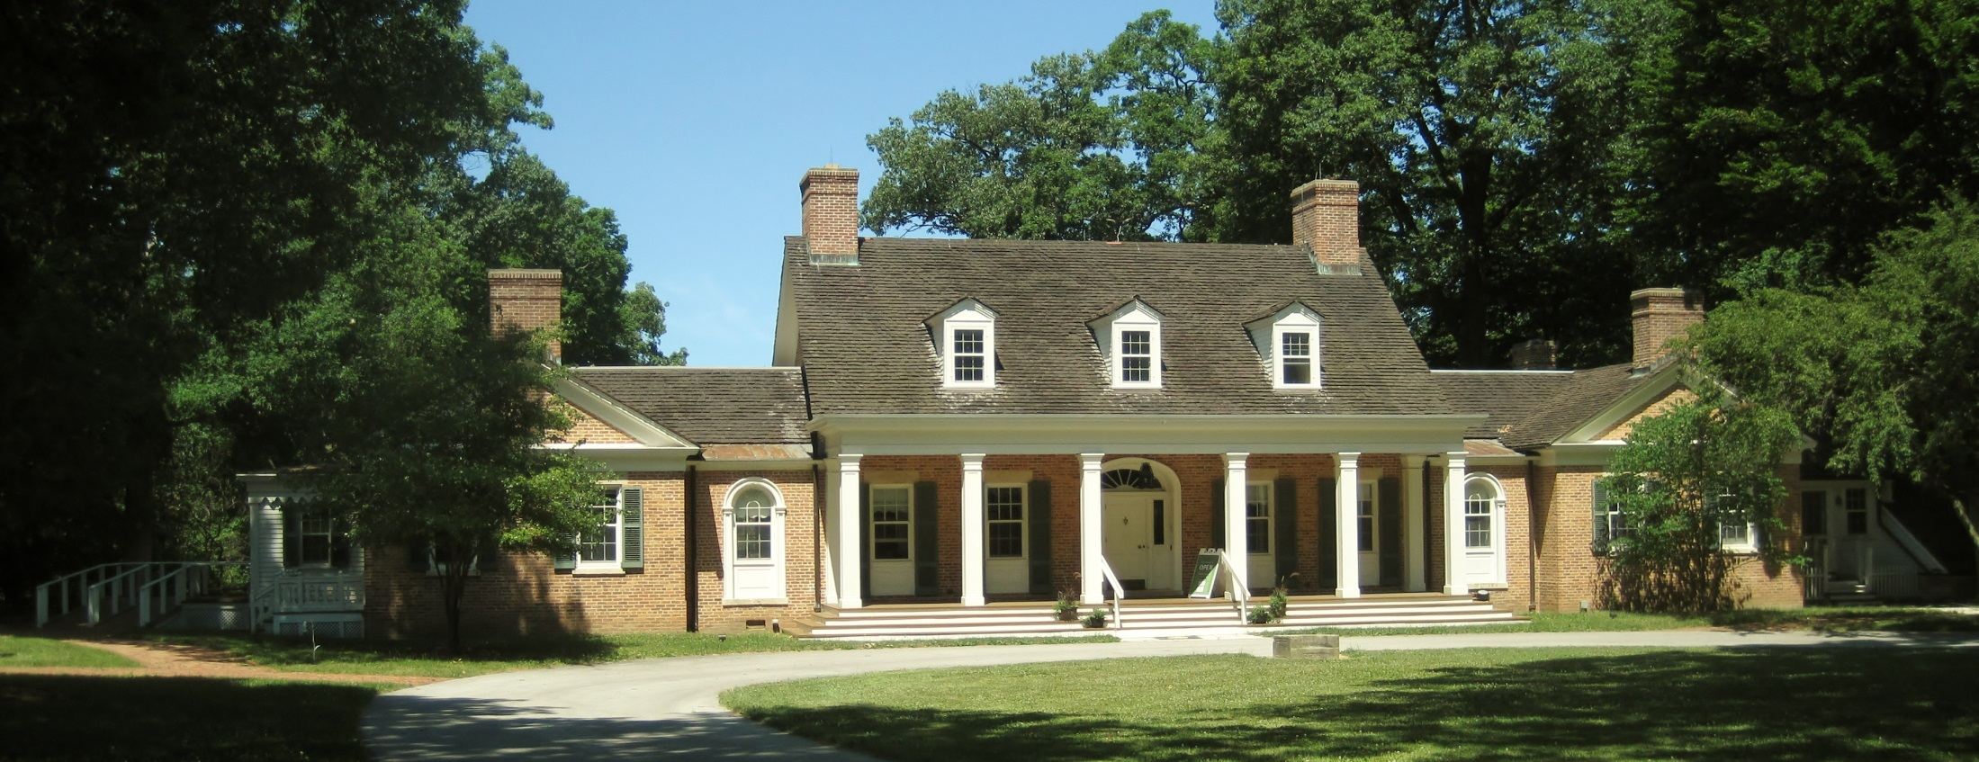
My Home
I love this house! I need a big house because I want a lot of kids!

Slide 5
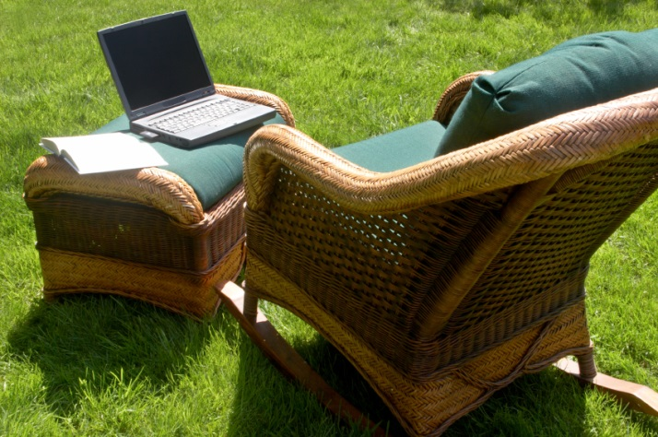
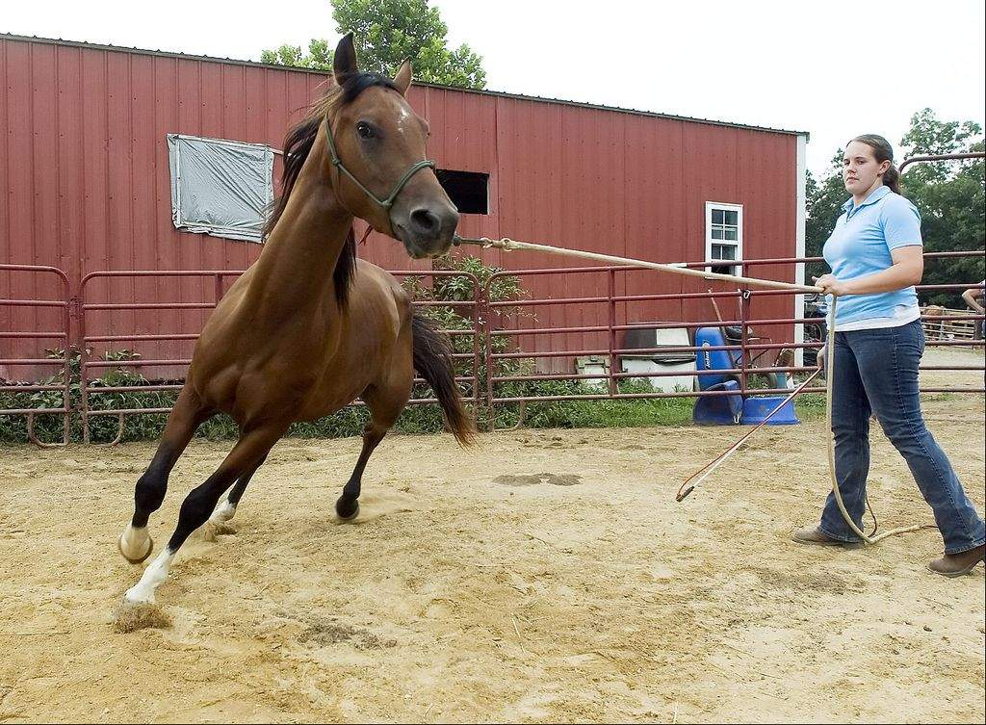
My Workplace
I haven’t thought much about where I will work. I’d love to work at home, but I know that’s kind of hard. I don’t think I’d be happy in an office though. Maybe somewhere where I can work outside.
I think it would be cool to be a horse trainer.

Slide 6
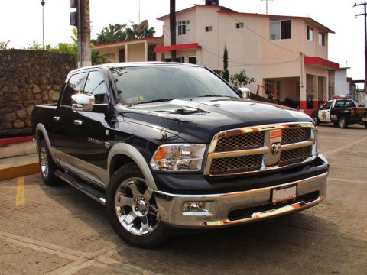
My Ride
I know EXACTLY what car I want to drive one day! I definitely want a Dodge Ram! Yeah! They are so big and roomy and I will need it if I live in the country!

Slide 7
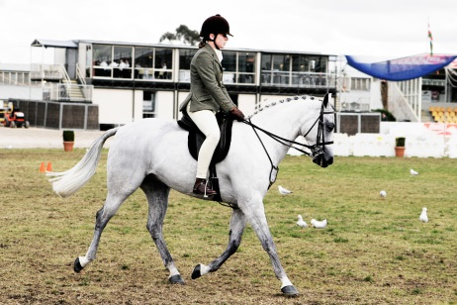
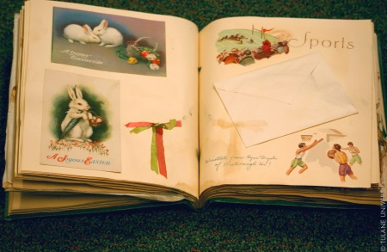
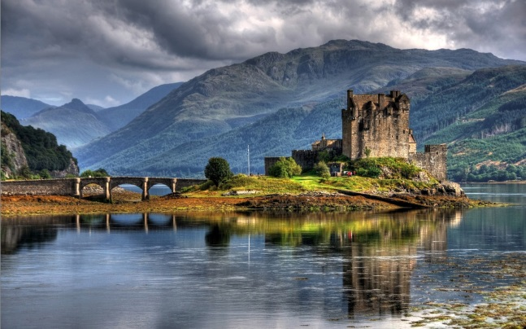
What I Do for Fun
I want to ride horses.
I love gymnastics, but I guess I probably won’t be doing it anymore when I grow up!
I want to keep an awesome scrapbook like my mom does.
My dream is go to Scotland—I want to take my family there one day!

